Slide 2
Getting started with GNUradio
Workshop, 22.09.2021

Slide 3
Agenda
Prerequisites
Overview, history and future of GNUradio
Installation
Basic concetps
First start
Overview of the GNUradio-companion tool
Blocks and the data-flow structure
Our first flow graph
Interacting with audio – source and sink blocks
Running the graph – understanding the ”compilation-process”
Threshold-blocks and when to use them
Running a graph via Terminal
File-sources, selectors and other concepts
Hierarchical blocks
Embeded python blocks, the quick way to incorperate custom functionality
Preview:
Creating you own custom blocks and out of three modules (grmodtool)
Interfacing with hardware

Slide 4
1: Prerequisites

Slide 5
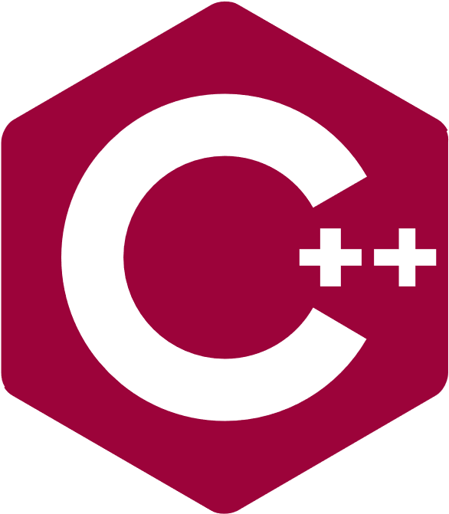
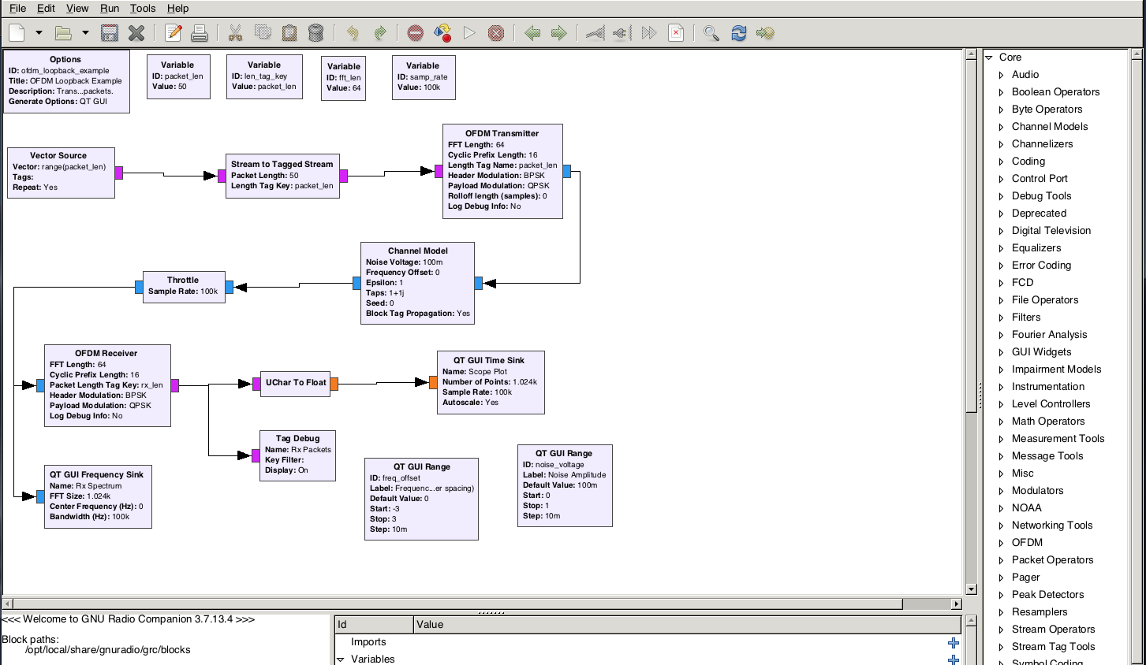

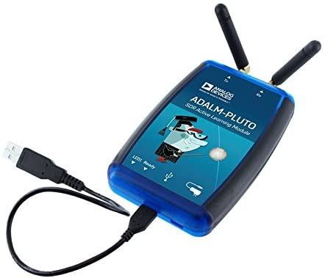

Overview GNURadio
GNU radio is a free, powerful and open-source SDK for signal processing
Can either be used for simulation or to interface real world hardware
Broad compatibility with external RF-Hardware
Written in C++ and Python
Notes:
GNU-Radio, Modules like simulink

Slide 6

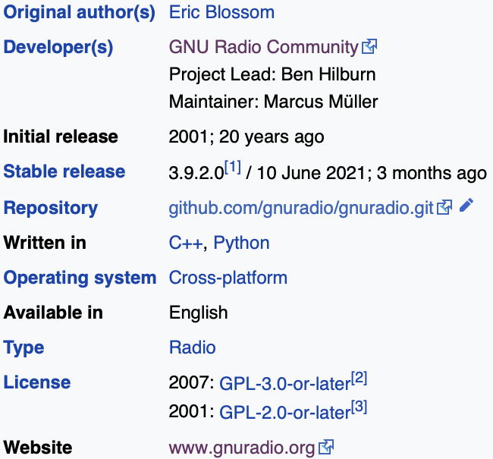

History and state of GNURadio today
GNUradio started as the brainchild of John Gilmore and Eric Bossom in 2001 and was based on Pspectra
Went through several overhauls with it’s more than 20 years history
Most recent stable release today is 3.9.2
Supported by many chairs, companies and enthusiast alike
Web presence | Docu | OOTs
Website Youtube Conference | Wiki Offical Blog BastiBl_Blog GRC-list | Library of OOTs Porting guide
Notes:
GRC Con just happened

Slide 7




Installation GNURadio
GNUradio officially supports all major operating systems including Windows, Mac and Linux
In reality only Linux can be recommended
From personal experience Ubuntu (e.g. LTS 20.04) is advised
Apart from that, Kali Linux (preinstalled GRC) or a Virtual Machine can be recommended
Prebuilt Binaries (via package manager) | using pybombs | from source | Os with packed GNUradio | Using a VM
For Ubuntu: For other distros | Pybombs is a build system specficially for GNUradio it is as simple to use as: | Either follow the instruction here or (if on Debian) check FactoriLabs install script | Kali Linux PiSDR | E.g. VirtualBox With the following Image
sudo apt install gnuradio
sudo apt install virtualbox-ext-pack
sudo -H pip3 install PyBOMBS
pybombs auto-config
pybombs recipes add-defaults
pybombs prefix init ~/gnuradio -R gnuradio-defaulty
🥧
*a live system can also be setup given this tutorial
** Apple Silicon builds are nearly impossible right now, with some success reported here
Notes:
Recommended install KALI or go with Ubuntu

Slide 9
2: Basic concepts

Slide 10
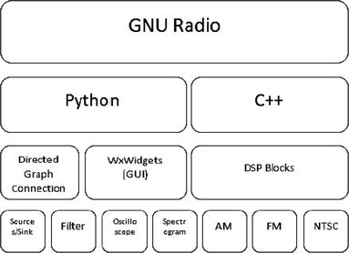
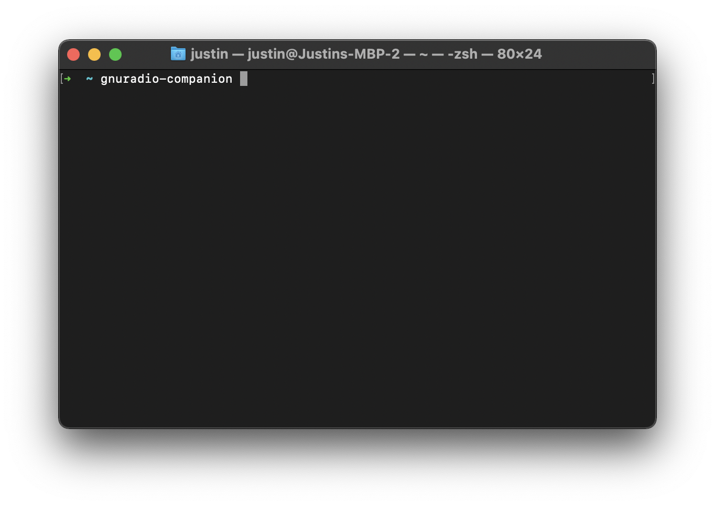
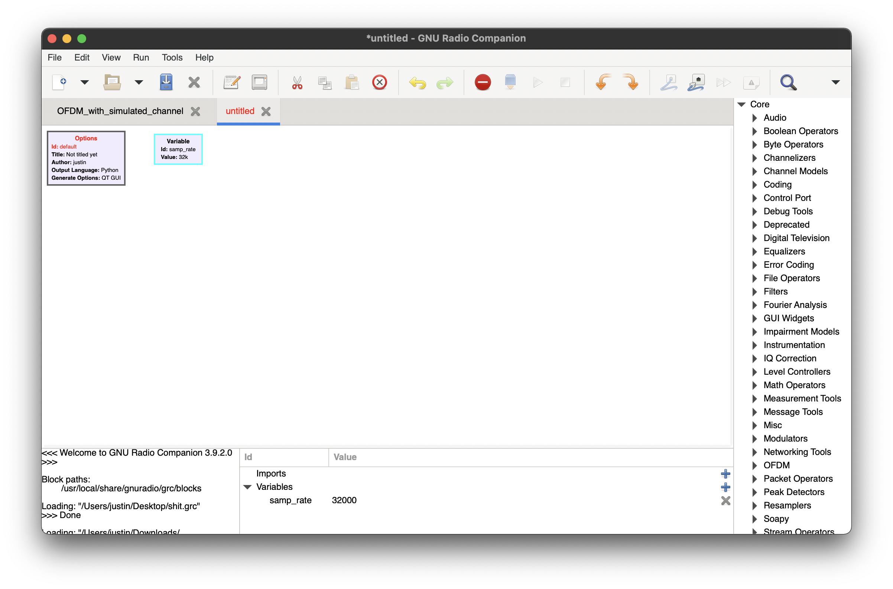
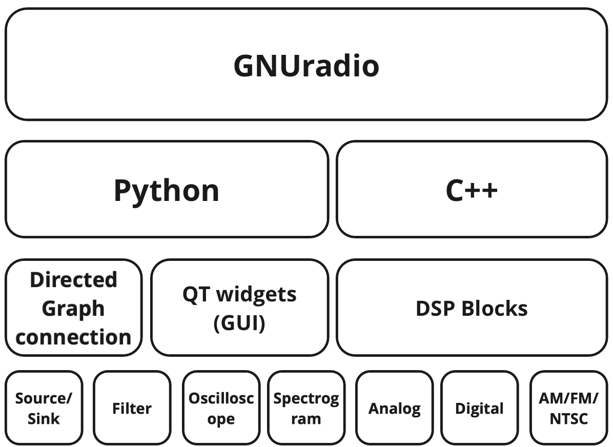
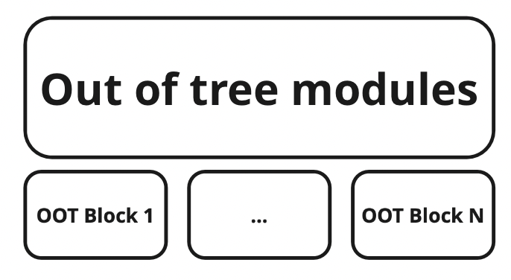
GNUradio 101: GNUradio-companion
GNURadio actually of several applications
Notes:
GNU-Radio, Modules like simulink

Slide 11
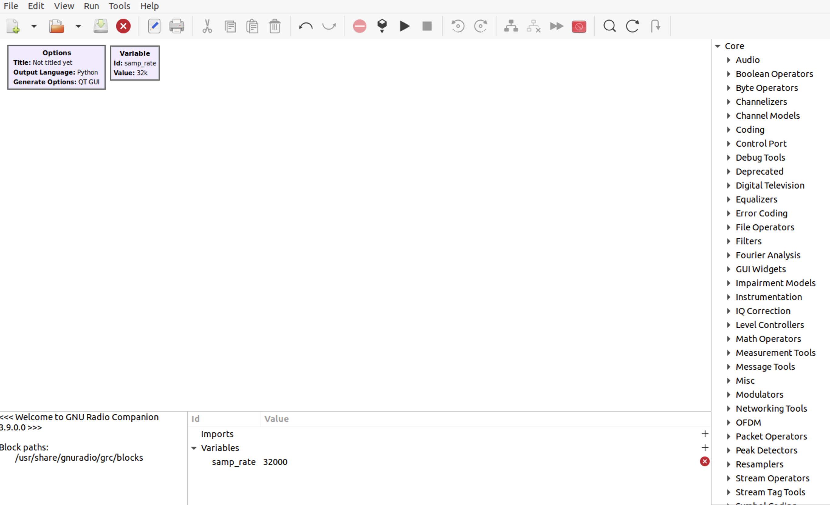
GNUradio companion: The GUI
Three main areas: TOOLBAR CANVAS, BLOCK TREE PANEL and the “DEBUG-AREA”
TOOLBAR
CANVAS
BLOCK TREE PANEL
DEBUG-AREA
Notes:
Canvas = play area

Slide 12
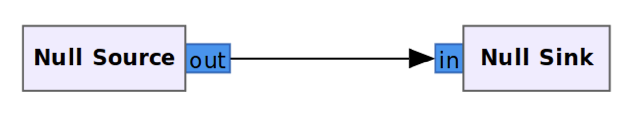
Using GRC: Flowgraph basics
Basic concept #1: Data flows from source to sink
Processing takes place here
Notes:
GNU-Radio, Modules like simulink

Slide 13
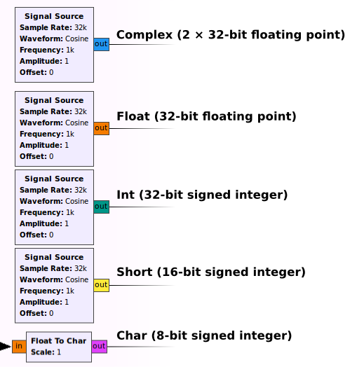
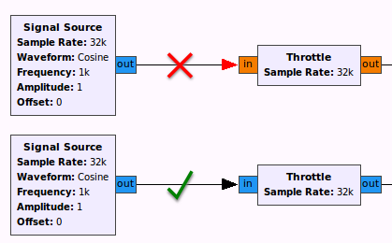
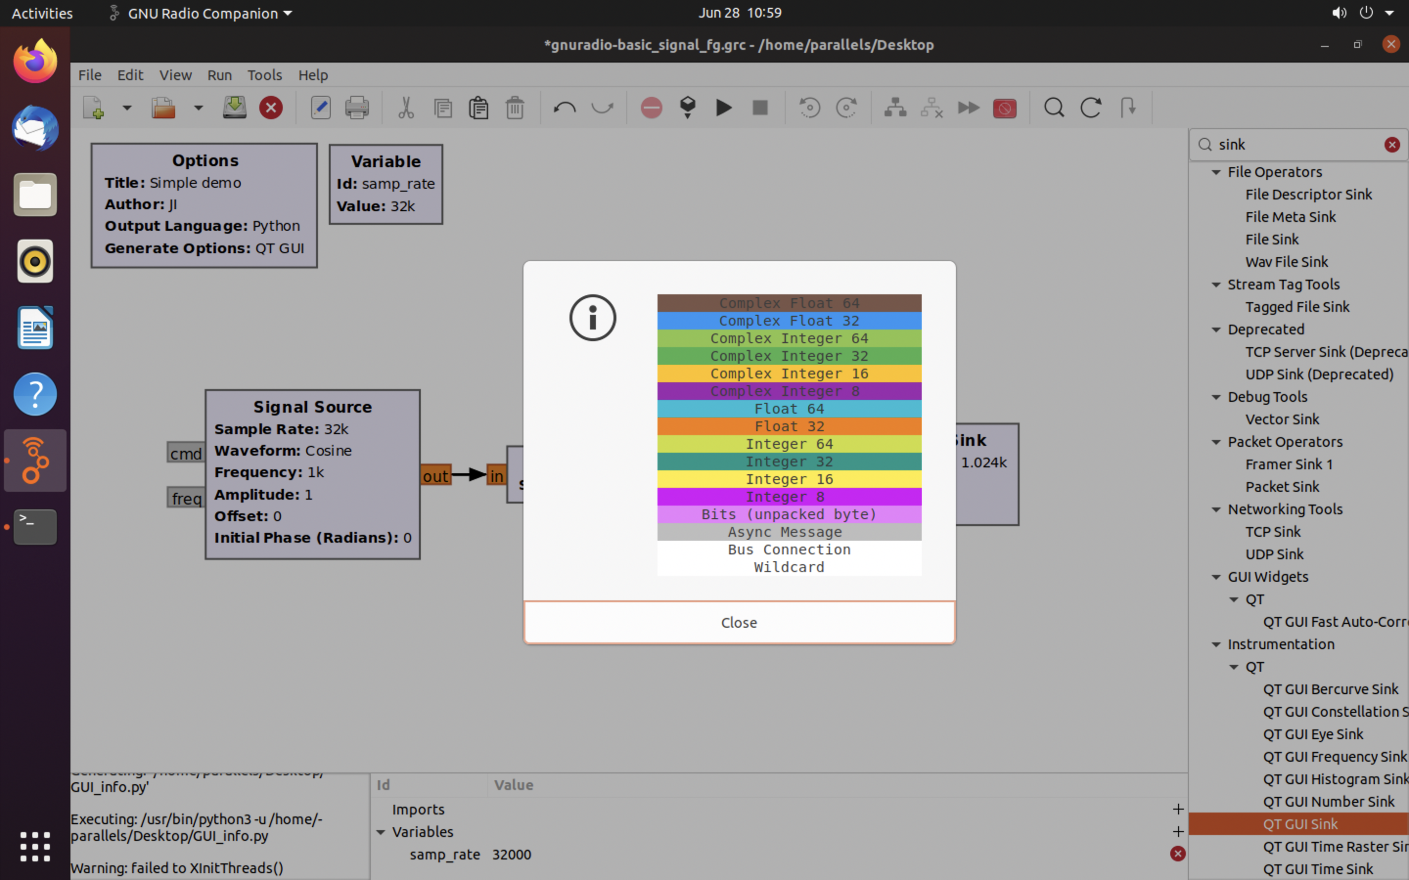
Using GRC: Running the graph
Basic concept #2: There are several data types, that are not directly compatible with each other
This information can be displayed via the Help-section in GRC by clicking on Types
You can change the data type from within the block-settings or by using the arrow-keys
http://blog.sdr.hu/grblocks/types.html
Notes:
GNU-Radio, Modules like simulink

Slide 15
3: Our first flow graph

Slide 16
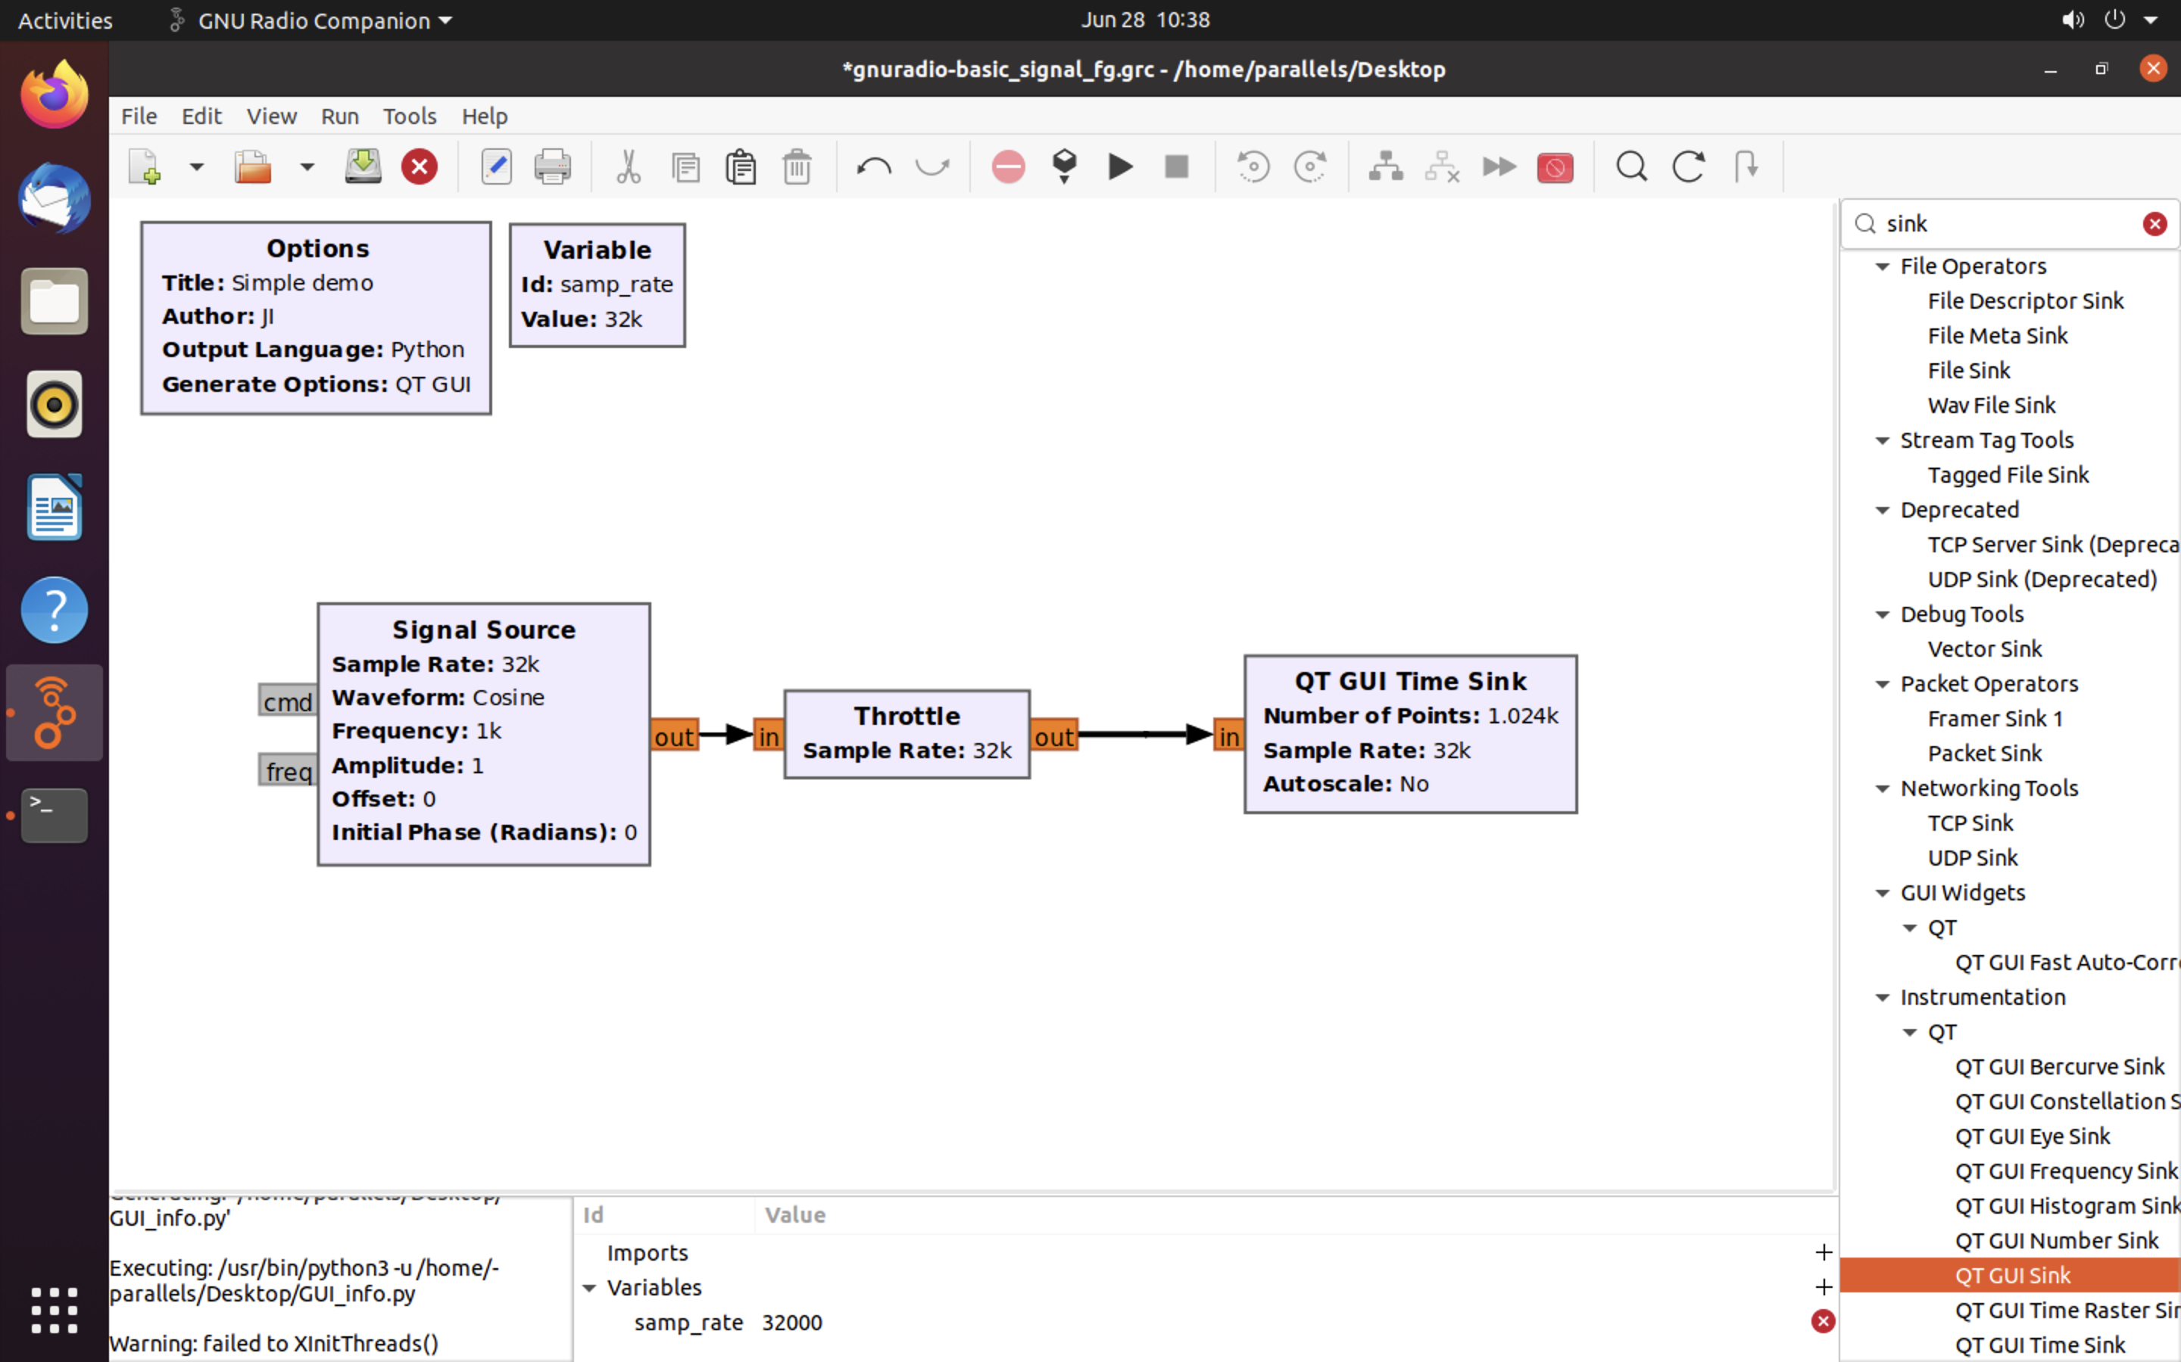
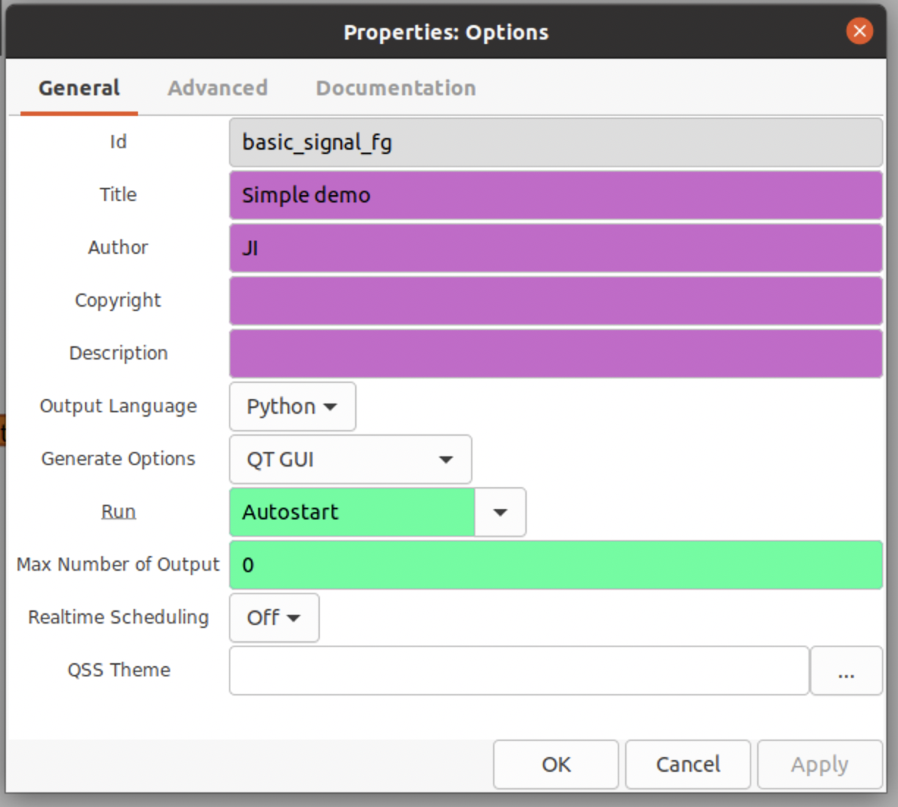
Using GRC: Initial settings and Graph types
The first step when creating our first flowgraph is to assign an ID/Title and check for Output Language and Generation Options by double clicking on the Options-block
We will go into further detail on our options here in later slides, for now the settings depicted below are enough
Flow graphs are composed of different blocks (basic block ship with GRC, with more available online as OOT-modules)
Notes:
GNU-Radio, Modules like Simulink Why and when do we need a throttle?
Basic data-type concept
Why and when do we need a throttle? -> In cases were no "consumer” is available, a “Throttle”-block becomes necessary (otherwise, the CPU)

Slide 17
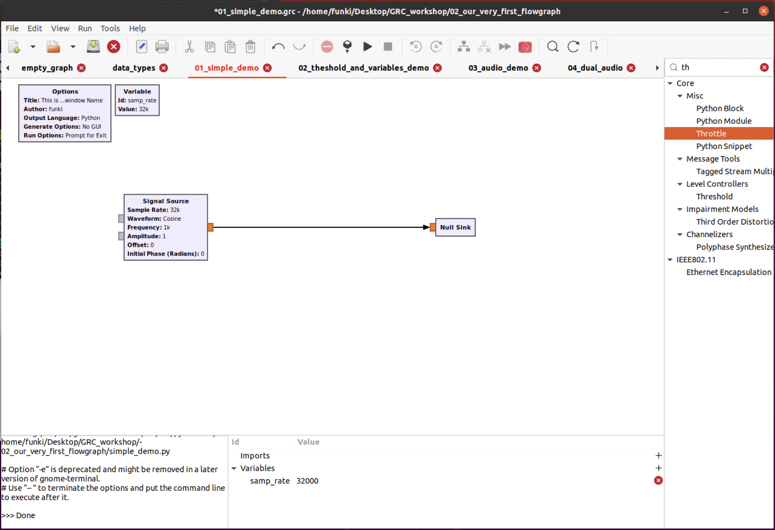
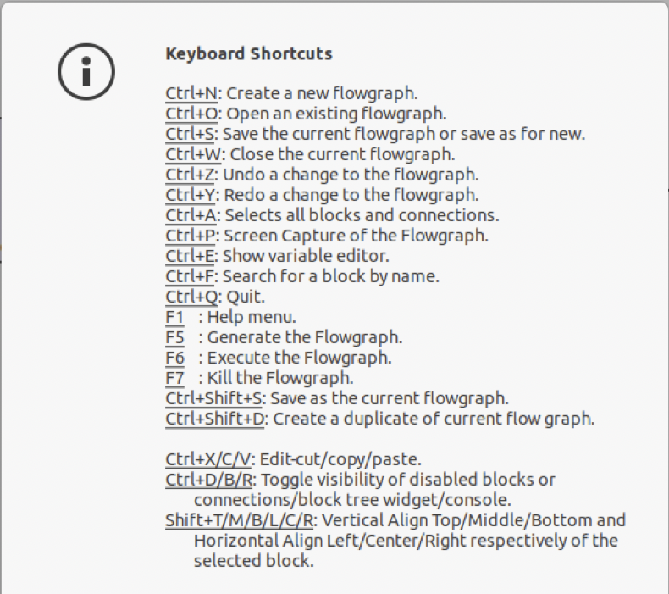
Using GRC: Our very first flowgraph
Basic flowgraph from singal to source
Shortcut | Action
Mousewheel | Zoom
D | (Toogle) Disable block
B | (Toggle) Bypass block
CTRL+D | Toogle visability of disabled Blocks
Arrowkey Left-Right | Rotate Block
Notes:
GNU-Radio, Modules like Simulink Why and when do we need a throttle?
Basic data-type concept
Why and when do we need a throttle? -> In cases were no "consumer” is available, a “Throttle”-block becomes necessary (otherwise, the CPU)

Slide 18
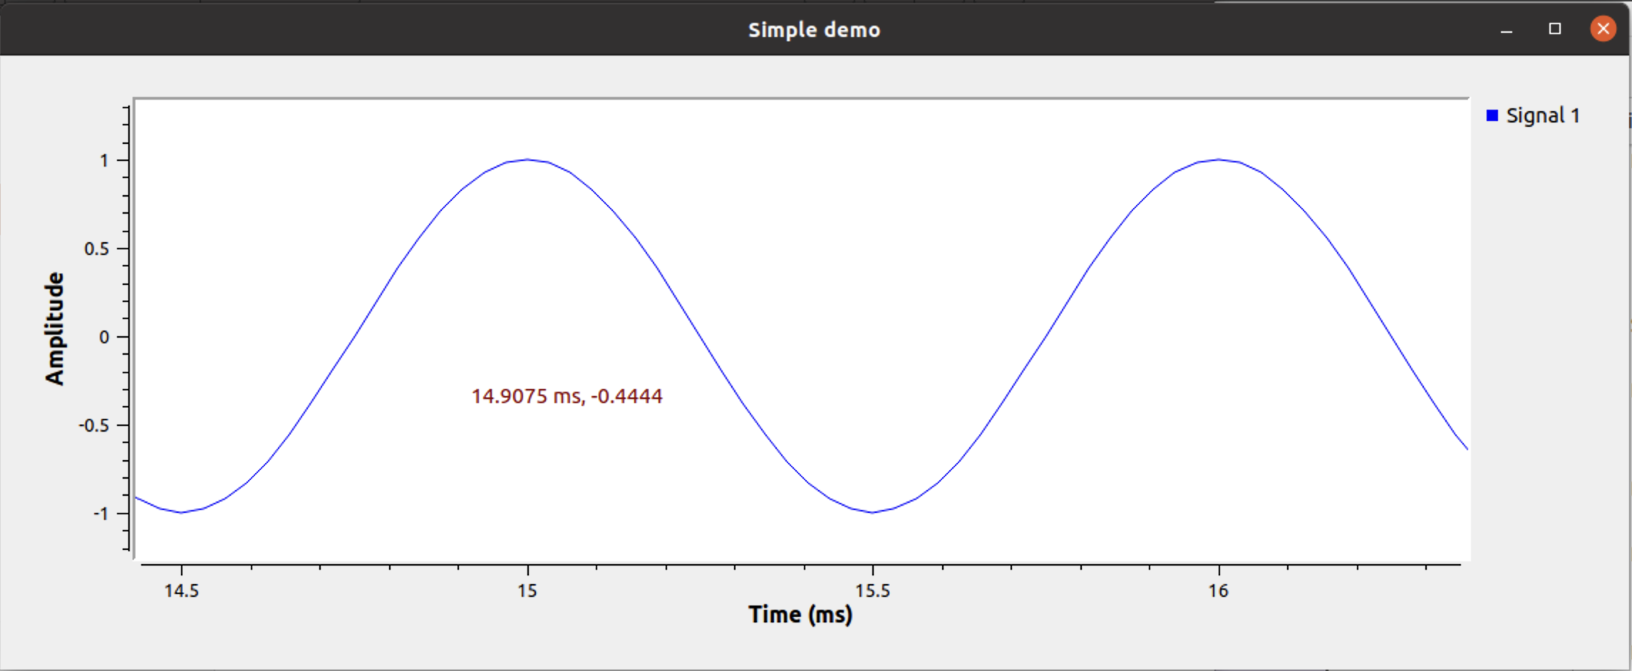
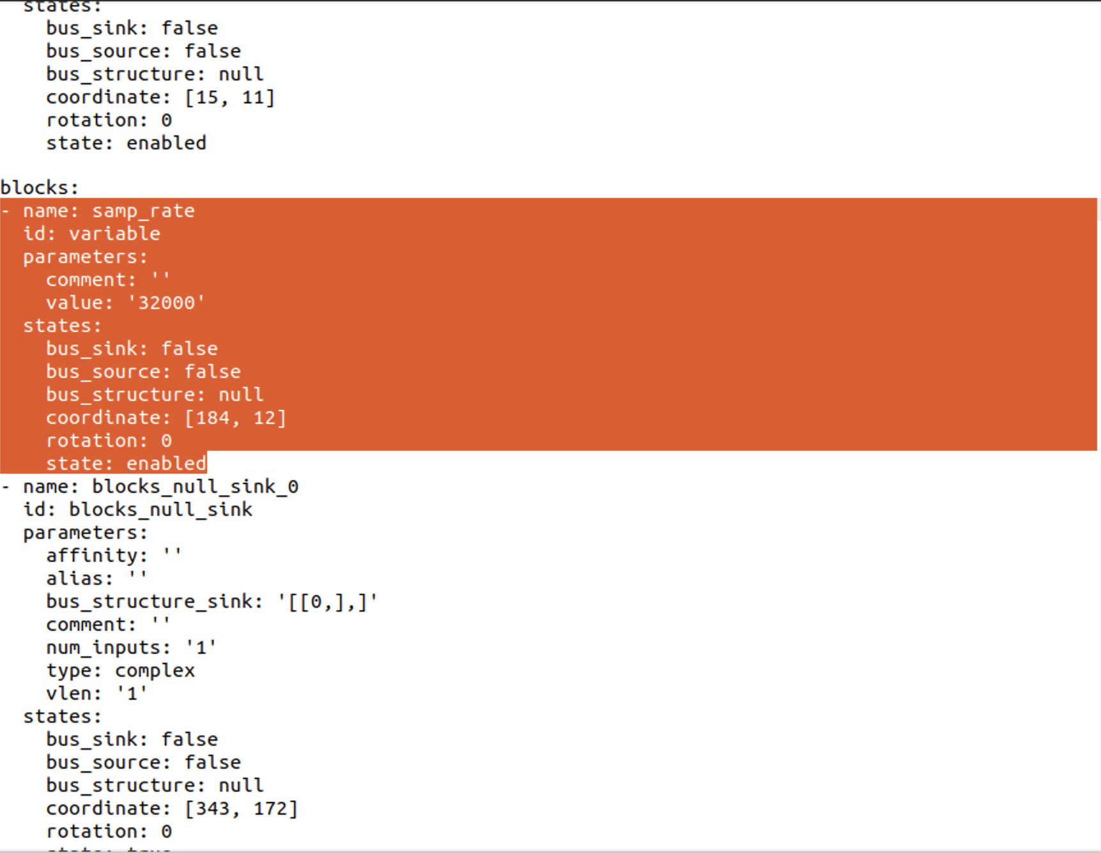
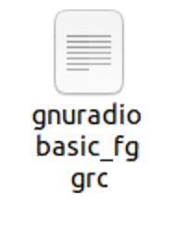
Using GRC: Building and running a graph
basic_signal_fg.py
“Generate”
“Run”
A three-step process
Creation of a flow-graph in Gnuradio-Companion
(Python) Code generation
Running the graph
“Terminate”
Notes:
GNU-Radio, Modules like Simulink Why and when do we need a throttle?
Basic data-type concept
Why and when do we need a throttle? -> In cases were no "consumer” is available, a “Throttle”-block becomes necessary (otherwise, the CPU)

Slide 19
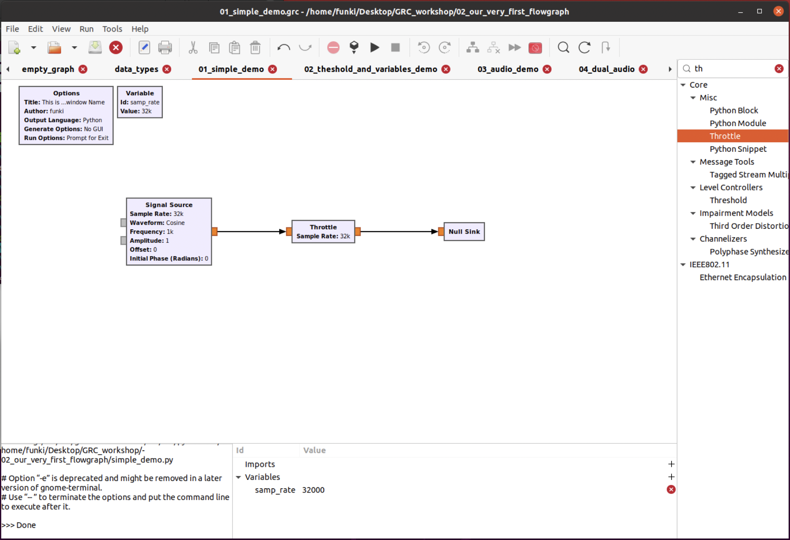
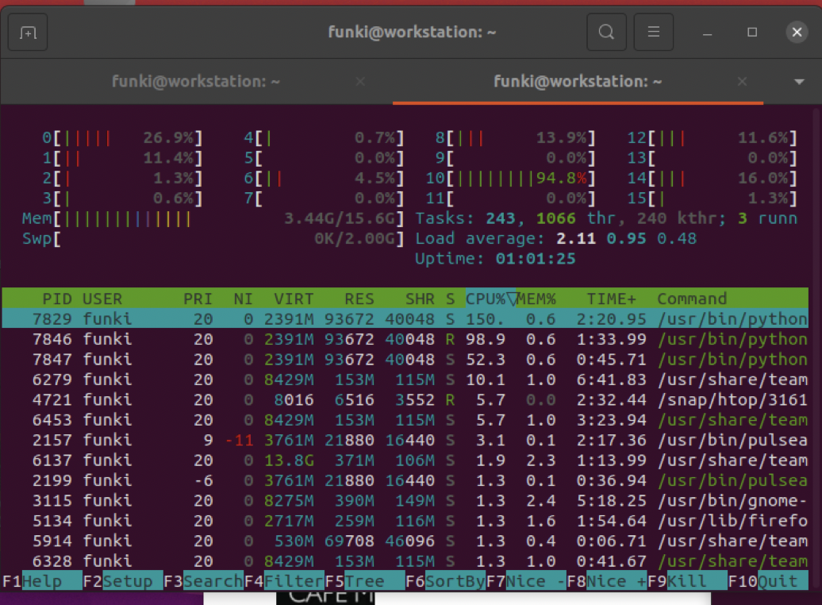
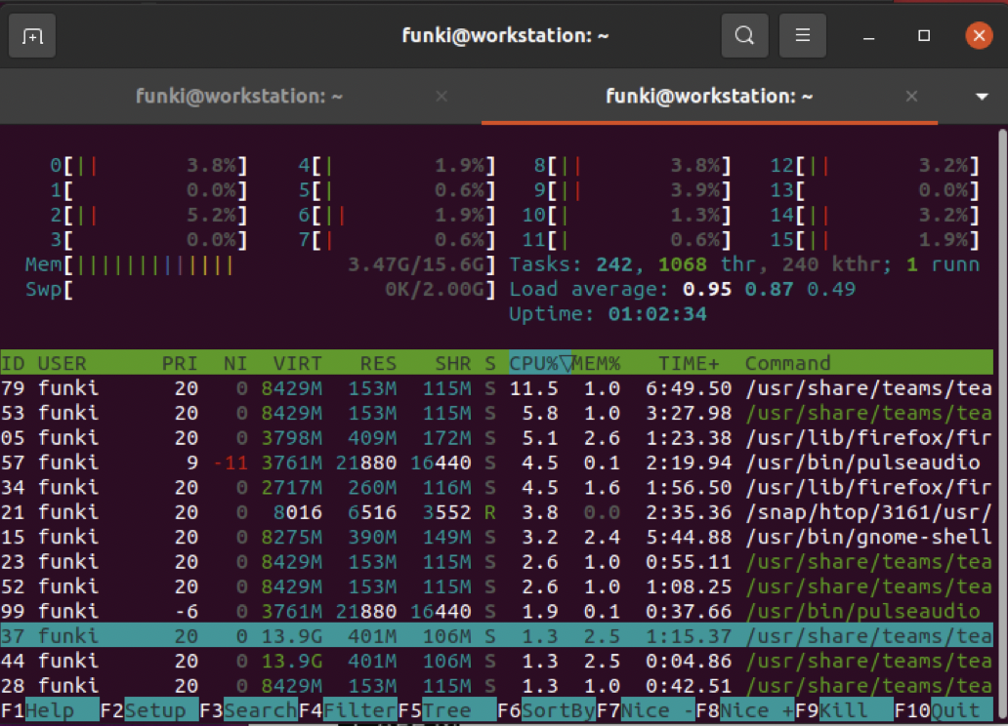
Using GRC: Running graphs from Terminal -> adding parameters
Throttle-blocks and why we actually need them
Graphs via Terminal
Interacting with them from Terminal-> python3 your_graph.py -[short_id] --[id] [value]
Refer to this wiki-page for more details
Notes:
Throttle blocks

Slide 20
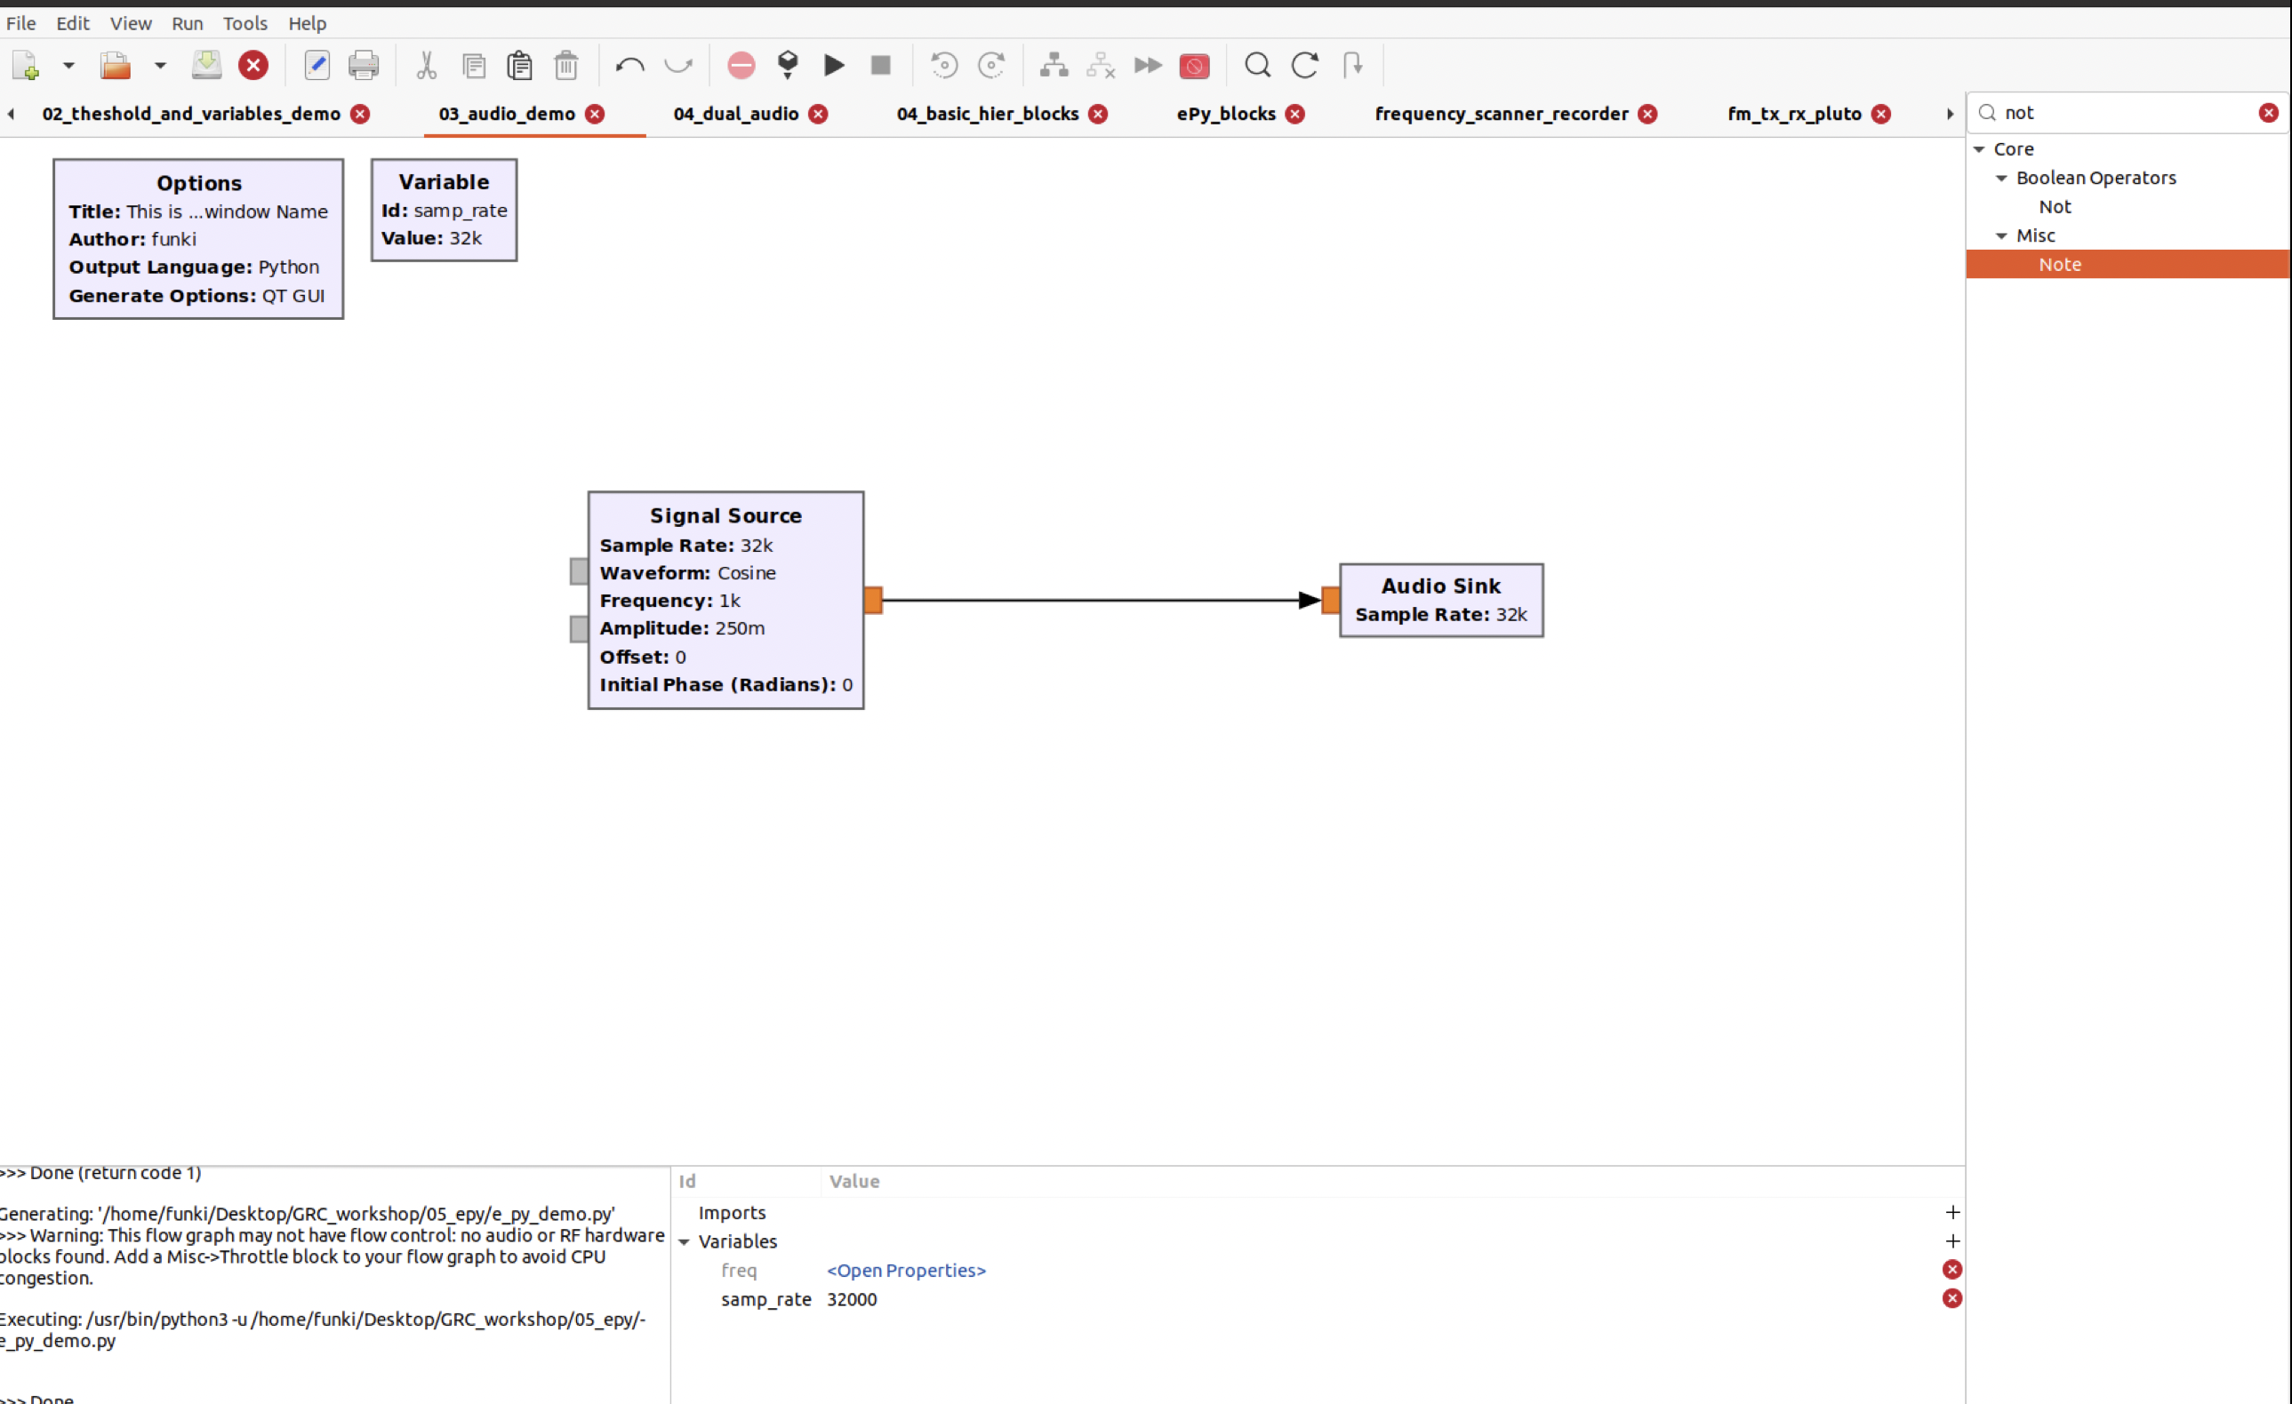
Using GRC: Interacting with Audio
Finding the necessary Blocks
Putting them together
Notes:
GNU-Radio, Modules like Simulink Why and when do we need a throttle?
Basic data-type concept
Why and when do we need a throttle? -> In cases were no "consumer” is available, a “Throttle”-block becomes necessary (otherwise, the CPU)

Slide 21
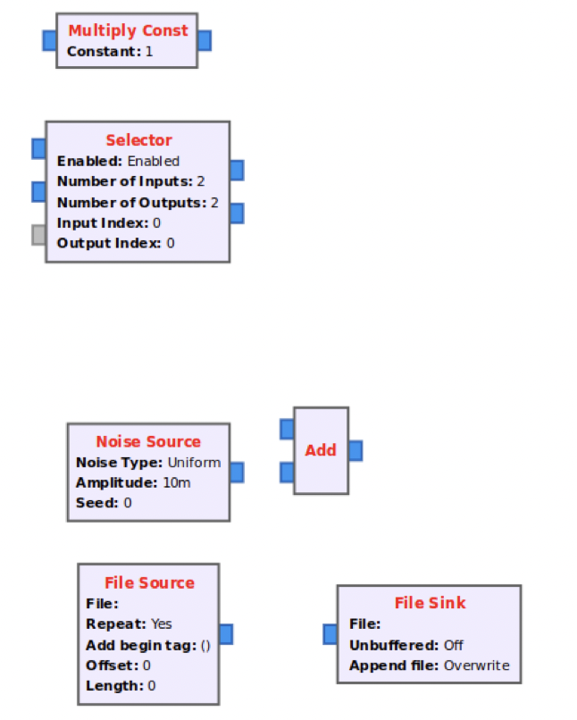
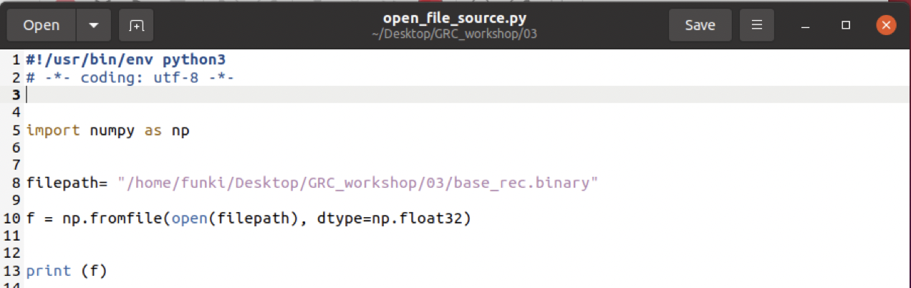
Using GRC: File-sources, Selectors and additions
Variables (QT-sliders)
Selectors / Combining signals
Adding noise
Using file sources
Files can be easily opened using Numpy*:
*instruction in the official FAQ
Notes:
GNU-Radio, Modules like Simulink Why and when do we need a throttle?
Basic data-type concept
Why and when do we need a throttle? -> In cases were no "consumer” is available, a “Throttle”-block becomes necessary (otherwise, the CPU)

Slide 23
Hierarchical blocks

Slide 24
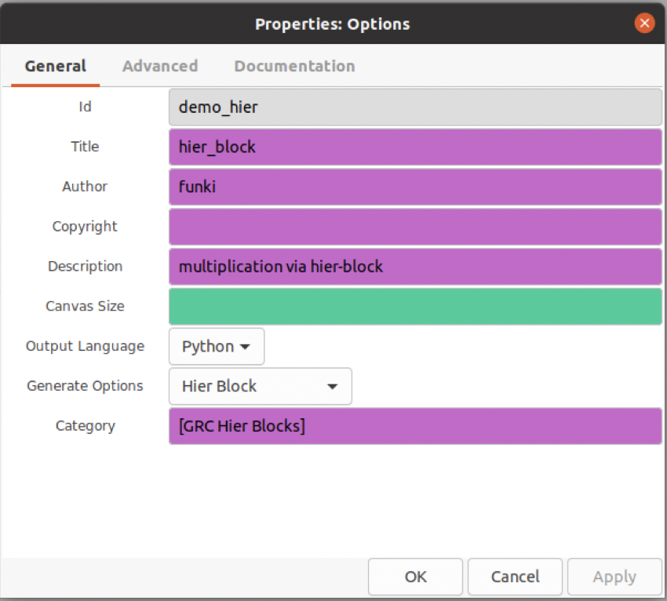
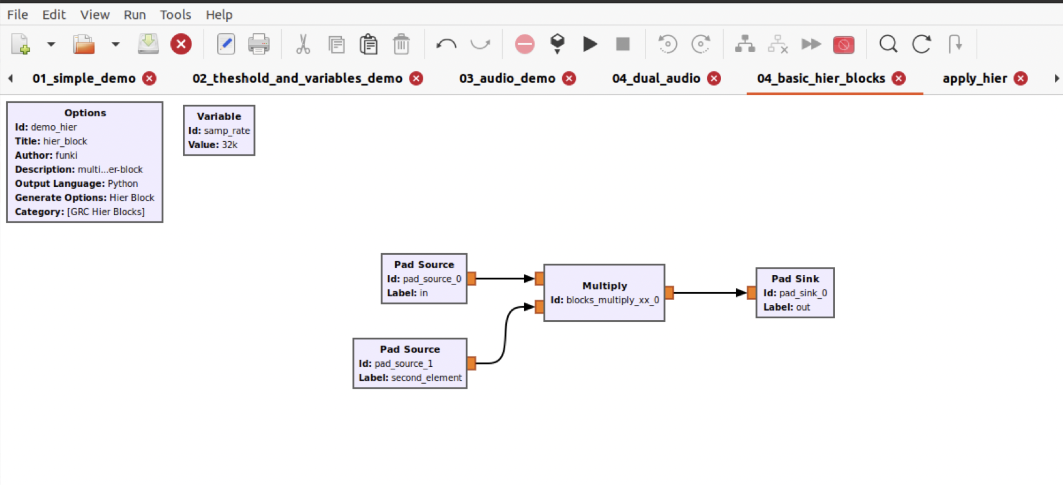
Hierarchical Blocks: Creating a hierarchical block
Hierarchical blocks are compositions of graph interactions in a abstract ”meta-block”
They make processing easier and flowgraphs much cleaner
Enable simple reuse of available subroutines
Main setting
ID/ Title
Type
Generation Options
Pads (types and other parameters)
Notes:
GNU-Radio, Modules like Simulink Why and when do we need a throttle?
Basic data-type concept
Why and when do we need a throttle? -> In cases were no "consumer” is available, a “Throttle”-block becomes necessary (otherwise, the CPU)

Slide 25
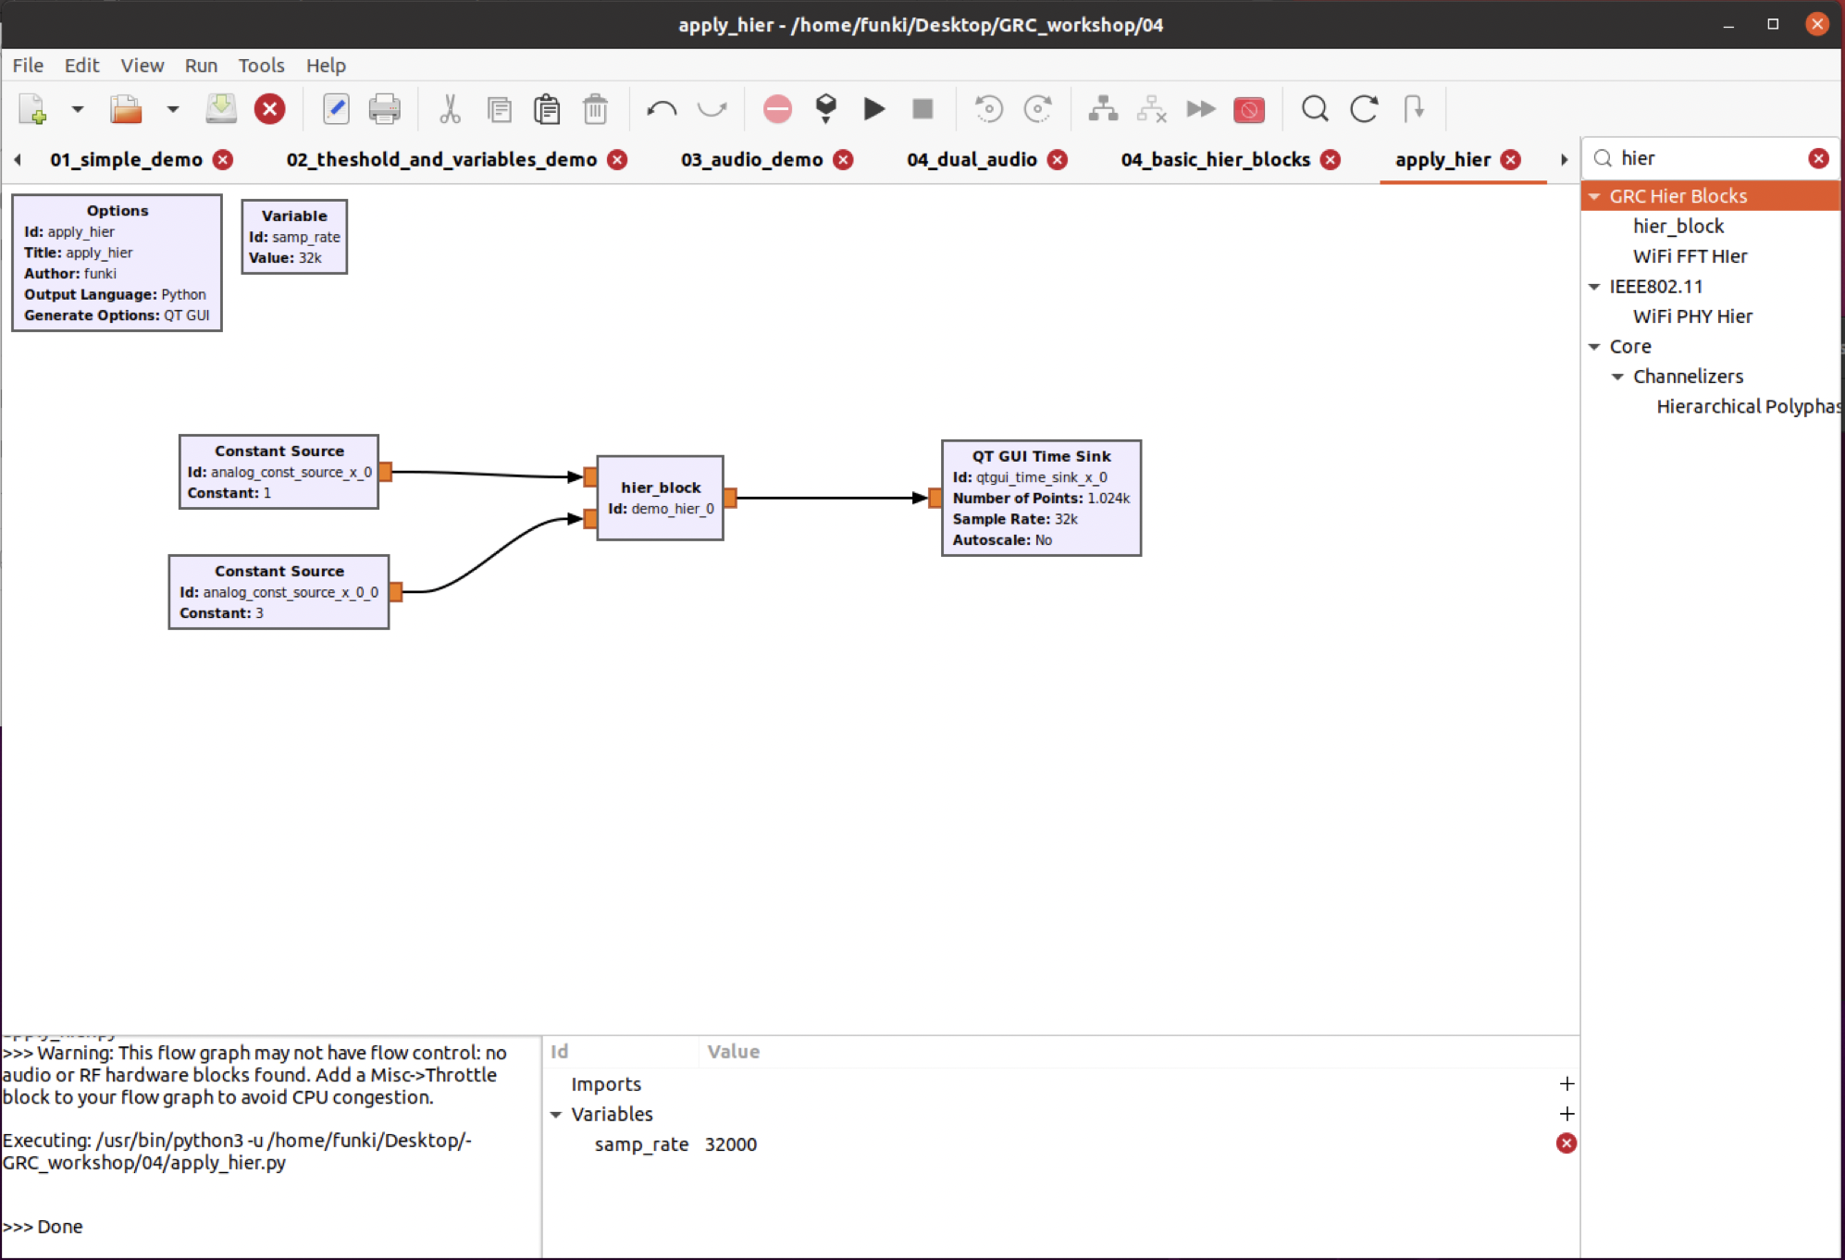
Hierarchical Blocks: Usage
Basically used as any other block
Notes:
GNU-Radio, Modules like Simulink Why and when do we need a throttle?
Basic data-type concept
Why and when do we need a throttle? -> In cases were no "consumer” is available, a “Throttle”-block becomes necessary (otherwise, the CPU)

Slide 27
Embedded Python Blocks

Slide 28
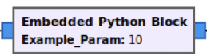
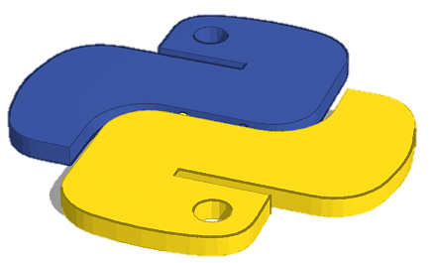
Embedded Python Blocks: The Concept
Embedded Python blocks (ePy-blocks) are the easiest way to implement custom functionality that goes beyond the available processing possibilities
Basically, python code within the graph
Inclusion of GNUradio internal as well as third-party-libraries possible
Fantastic for creation of GUIs and the like
Notes:
GNU-Radio, Modules like Simulink Why and when do we need a throttle?
Basic data-type concept
Why and when do we need a throttle? -> In cases were no "consumer” is available, a “Throttle”-block becomes necessary (otherwise, the CPU)

Slide 29
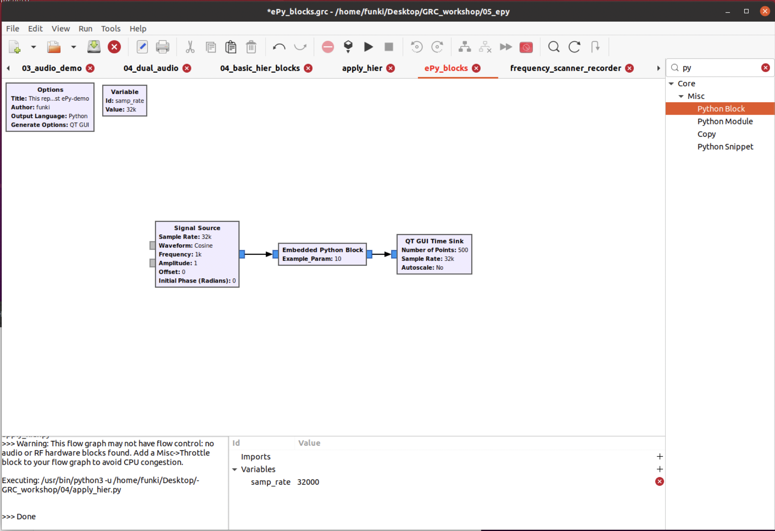
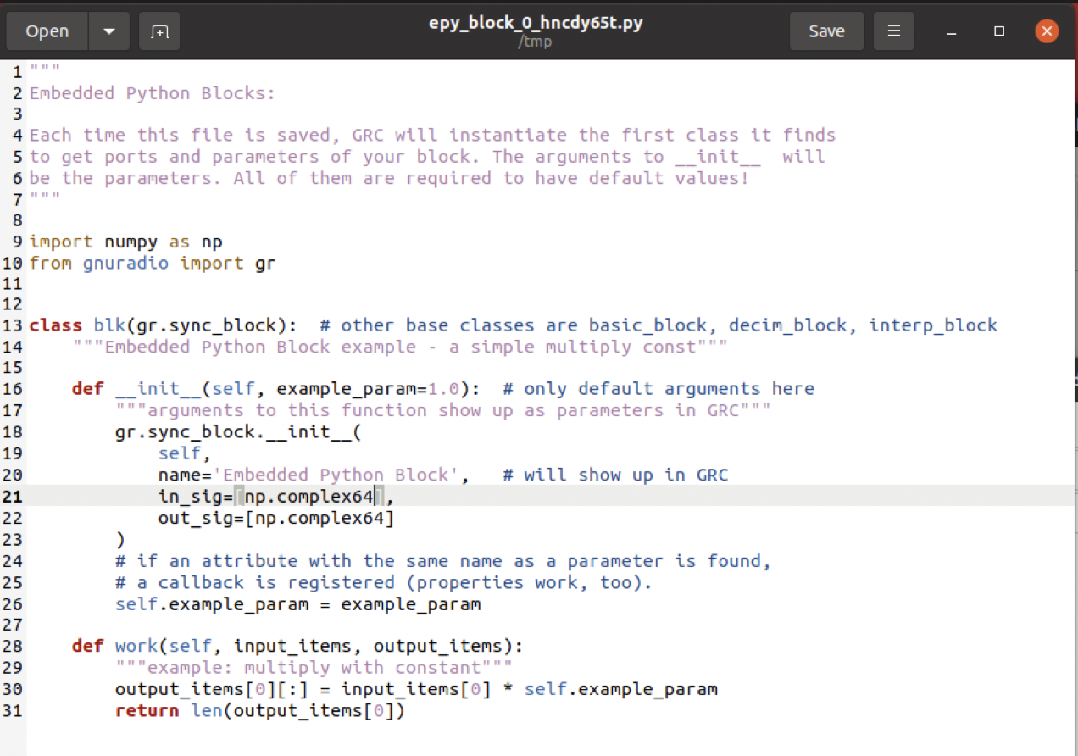
Embedded Python Blocks: Implementation
Adding an ePy-block
First look at the code
Making changes to the code
Notes:
GNU-Radio, Modules like Simulink Why and when do we need a throttle?
Basic data-type concept
Why and when do we need a throttle? -> In cases were no "consumer” is available, a “Throttle”-block becomes necessary (otherwise, the CPU)

Slide 30
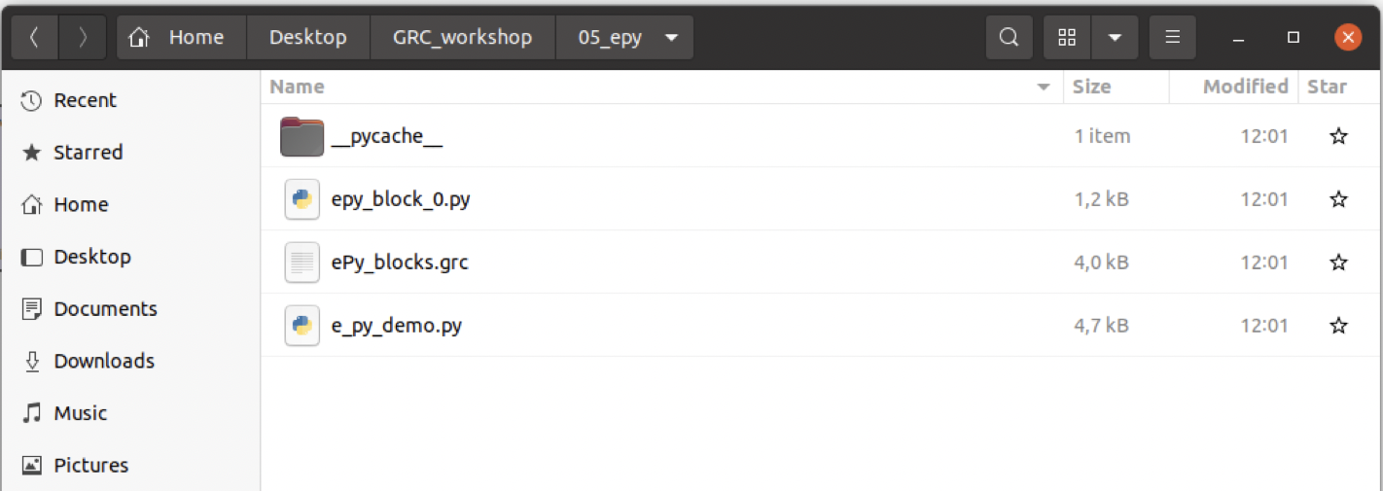

Embedded Python Blocks: Existing limits
Downside to the quick implementation is a rather dirty project setup
Code in theory easy to share but hardly reusable -> (need for reimplementation across several flowgraphs)
Speed constraints as python is the only available language…
Embeded Python Blocks are great for prototyping but should not be your first choice!
Notes:
GNU-Radio, Modules like Simulink Why and when do we need a throttle?
Basic data-type concept
Why and when do we need a throttle? -> In cases were no "consumer” is available, a “Throttle”-block becomes necessary (otherwise, the CPU)

Slide 32
Sneak preview: Block creation with the grmodtool

Slide 33
GR-Modtool
Other than using embedded Python Blocks, custom OutOfTree modules are a much cleaner setup
User can choose between two different programming languages with C++ offering much higher performance
The full build process is semi-automated and resulting modules can easily be shared
Also, OOT-module can hold more than a single block
Detailed step-by-step tutorial found at: https://wiki.gnuradio.org/index.php/OutOfTreeModules
Block Code in C++/Python
Build instructions
C++ Python wrapper setup
GUI block description
Documentation
Examples
Notes:
GR-Modtool auto-generates a GNU radio Module
C++ code can be integrated without much knowledge of the system

Slide 34
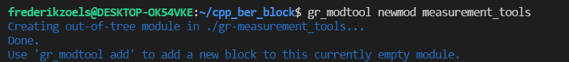
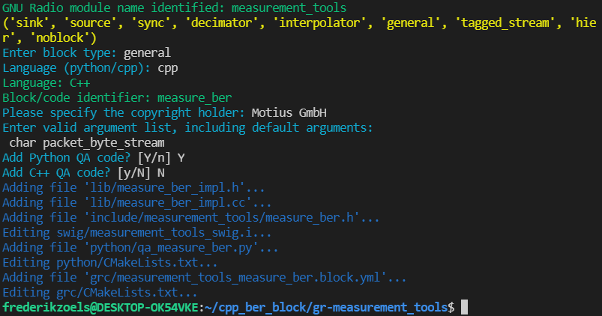
GR-Modtool
Creating a module
Module Structure
Create Block
Block types
gr::sync_decimator gr::sync_block
gr::sync_interpolator
gr::tagged_stream
Language
C++/Python
Copyright
Author..
Block-name
Name in Graph
Arguments
[Optional] List of Args
Additional QA-Code
[Optional] Toogle inclusion of QA-code-templates
…
Notes:
GR-Modtool auto-generates a GNU radio Module
C++ code can be integrated without much knowledge of the system

Slide 35
Sneak preview: Interacting with Hardware

Slide 36
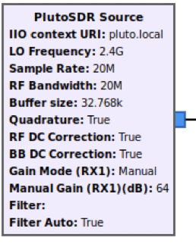
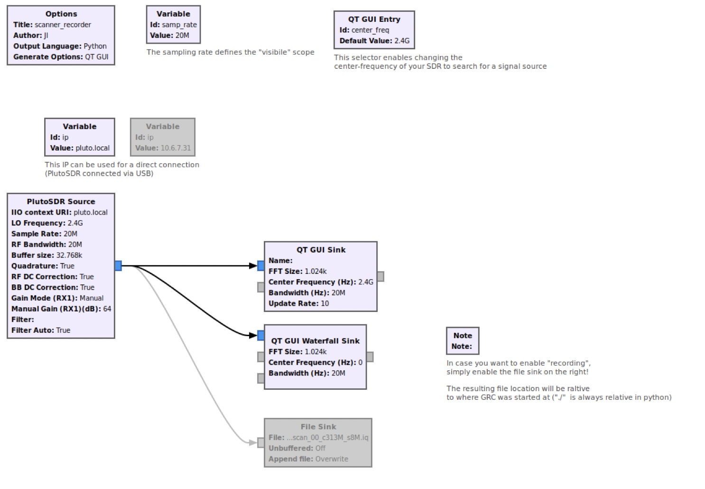
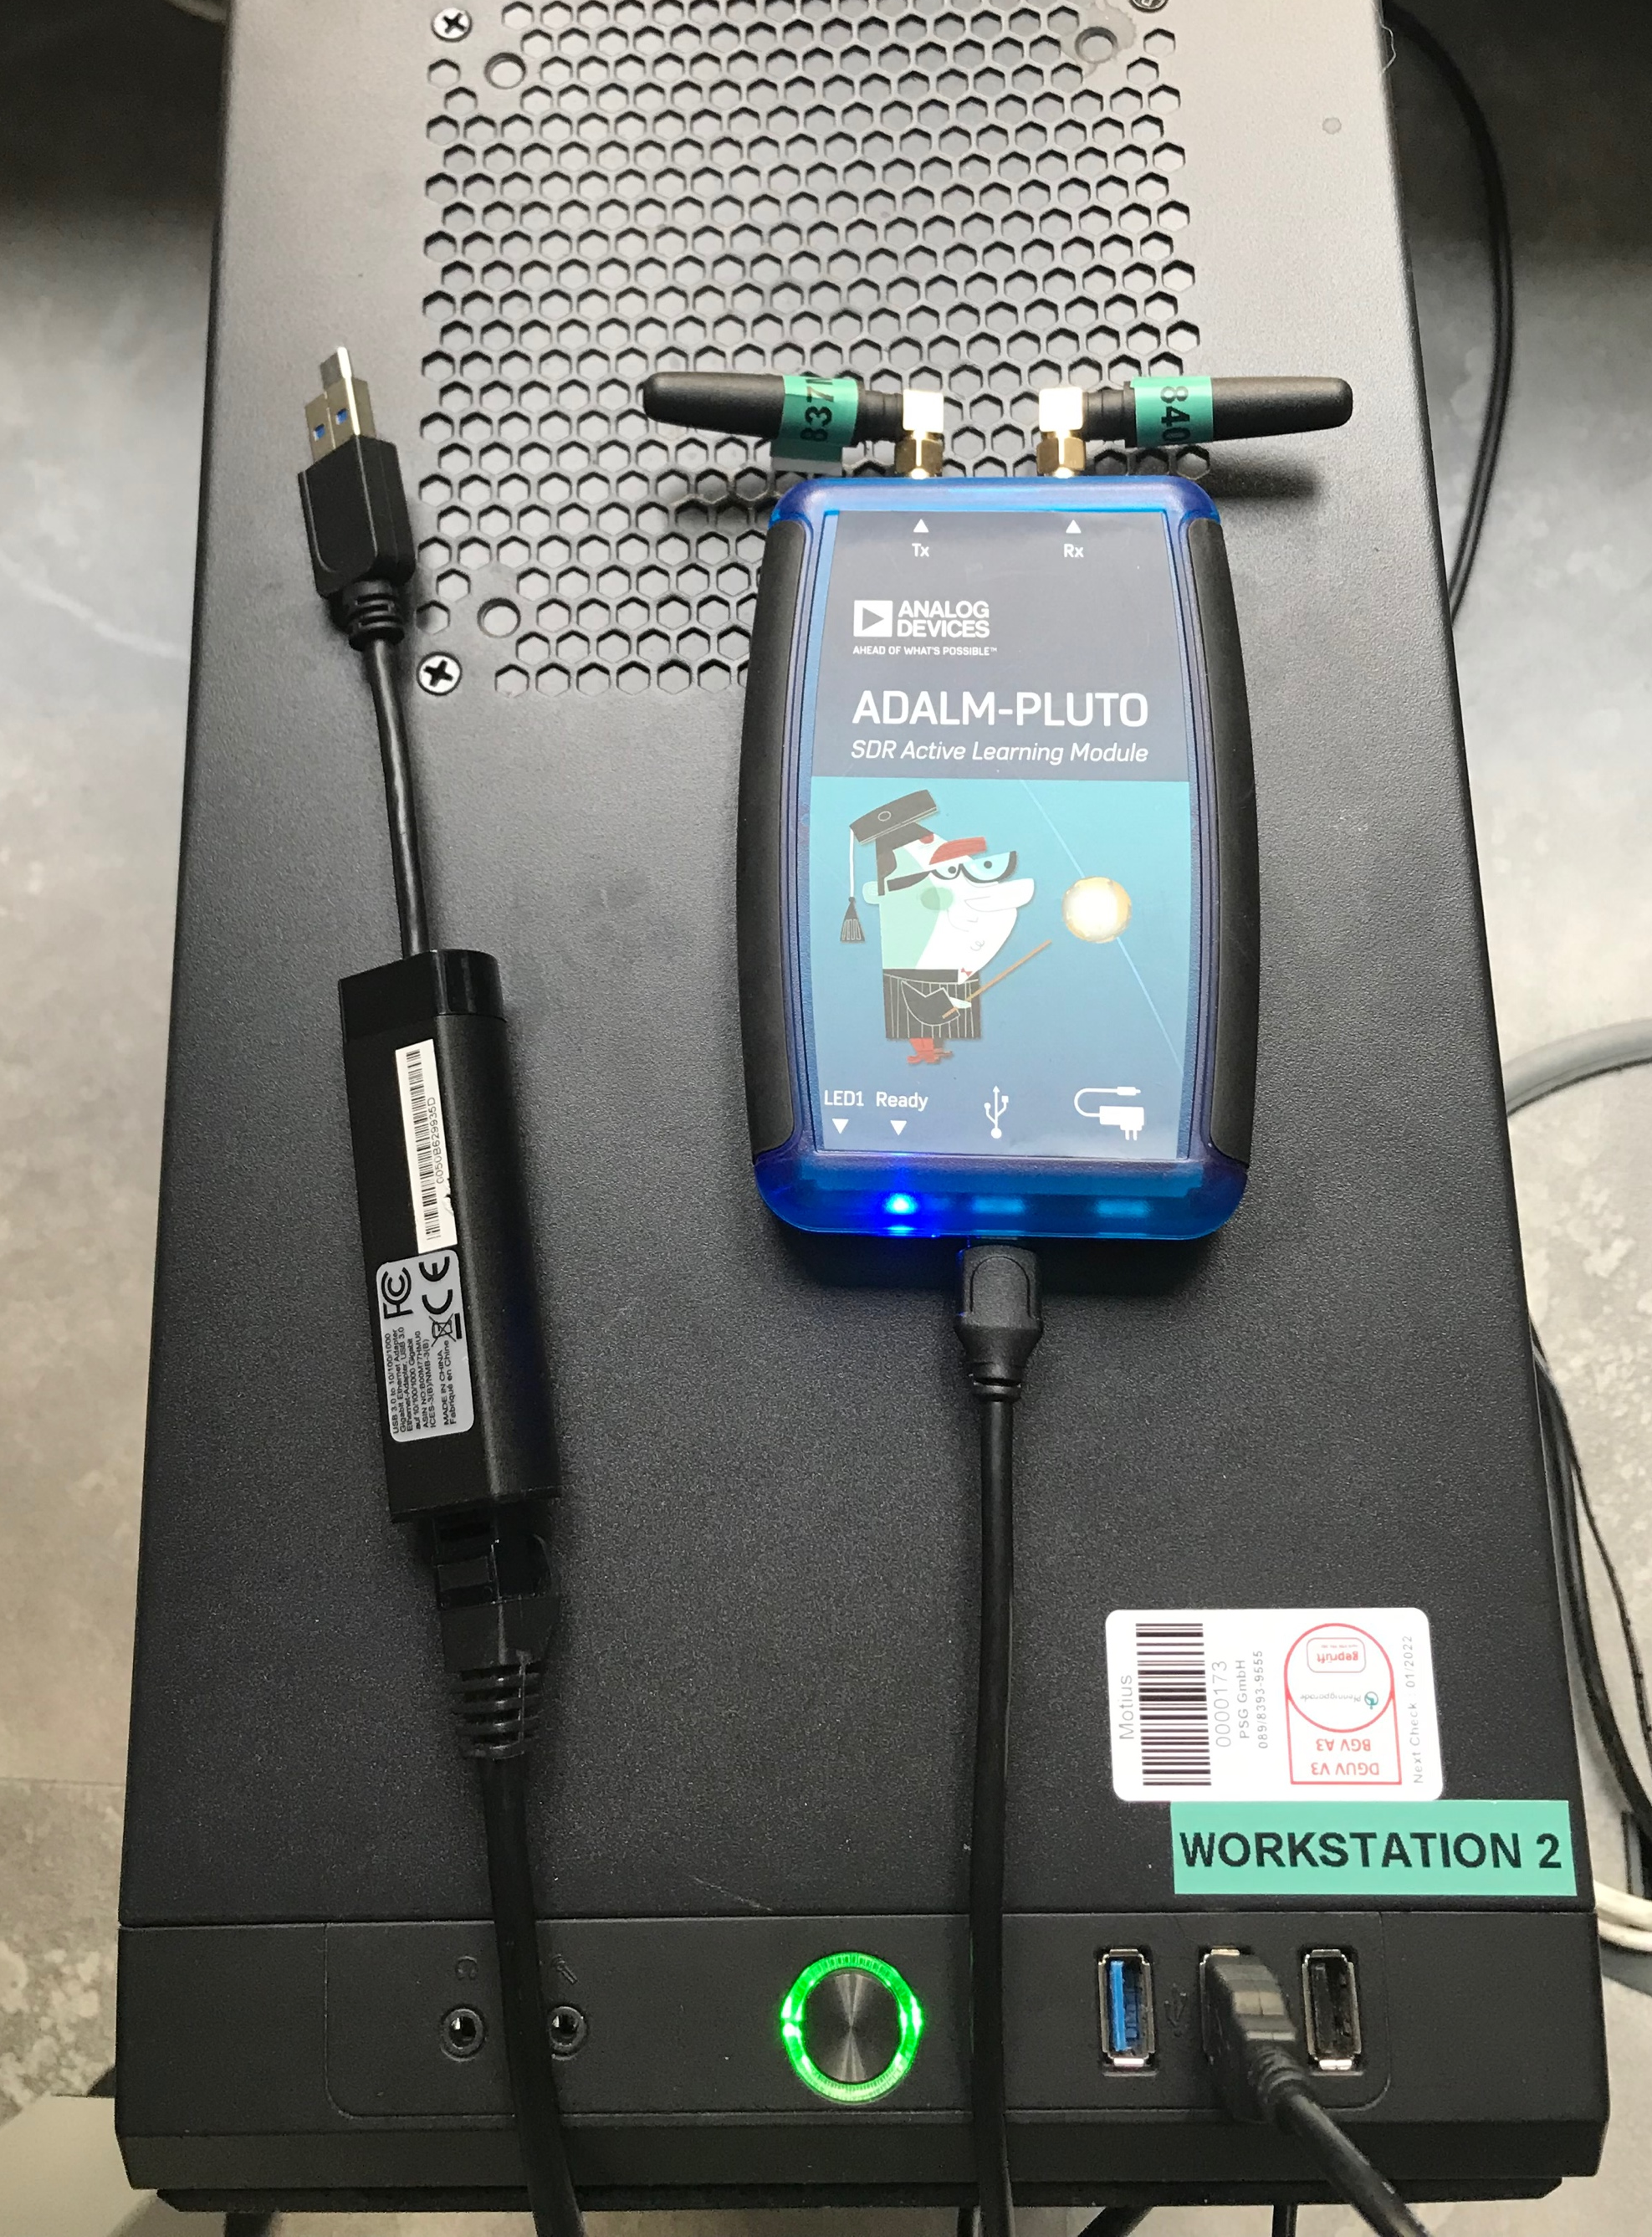
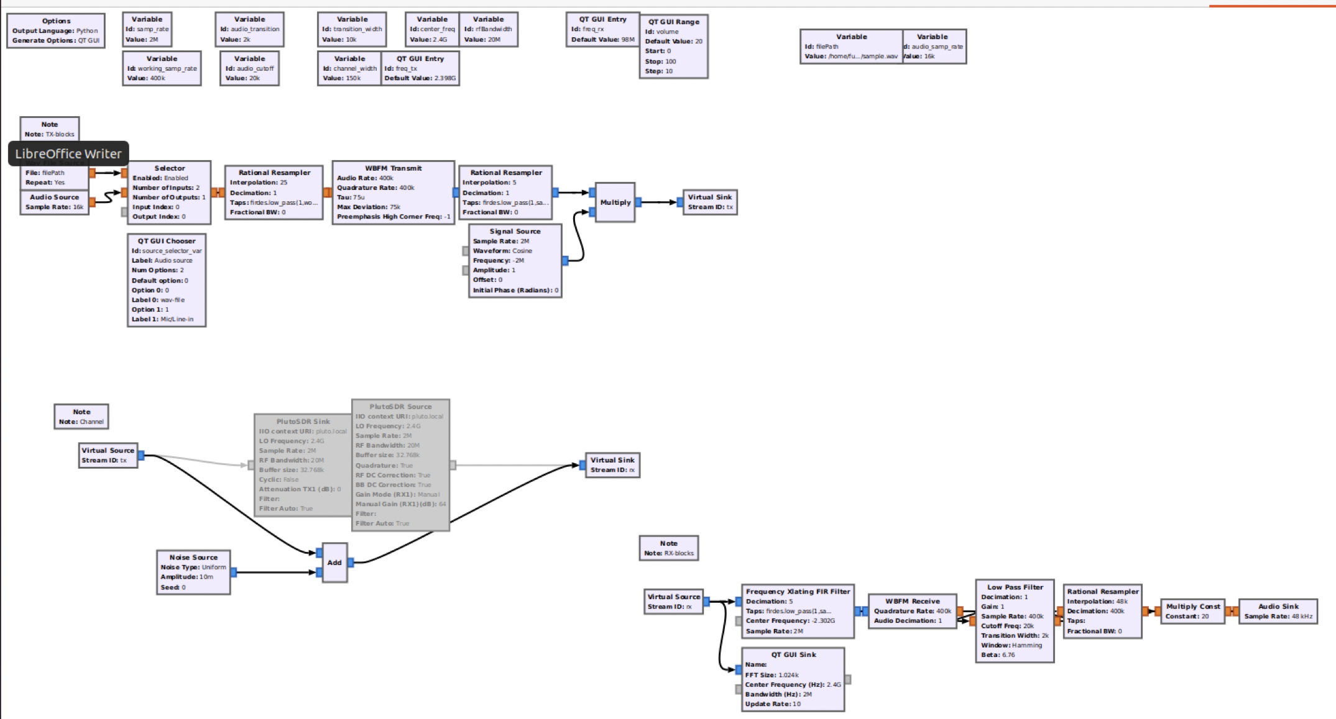
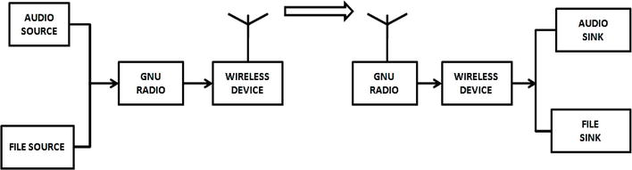
Using GRC: Sneak preview, interfacing with real hardware
Hardware is addressed the same way any other consume/sink works in GRC
Different systems are integrated via OOT blocks
Install Instructions for SDRs are either found on the manufacture's website with some available via tools like pybombs or install scripts
For the Pluto SDR in use, follow those instructions or make use of the install-script available at FactoriaLabs -> simply run cd install/grc-install/install_scripts ./hackrf_from_source.sh
A simple recorder
A FM-radio System
Notes:
GNU-Radio, Modules like simulink

Slide 38
Further materials

Slide 39
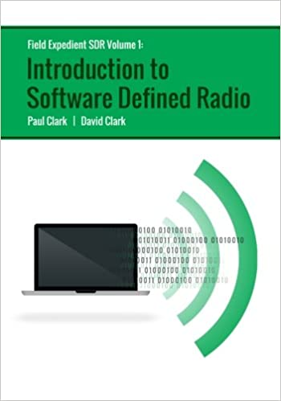
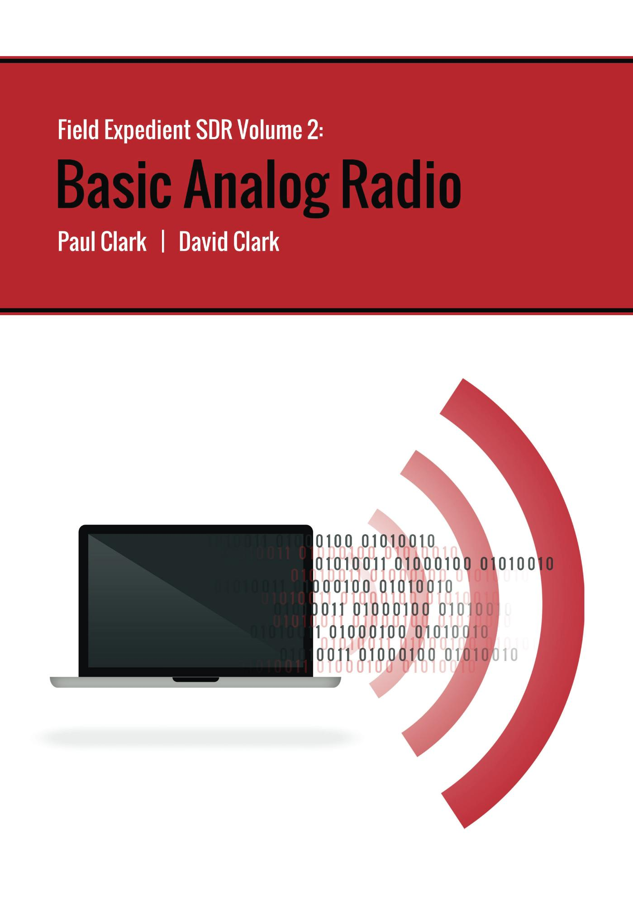

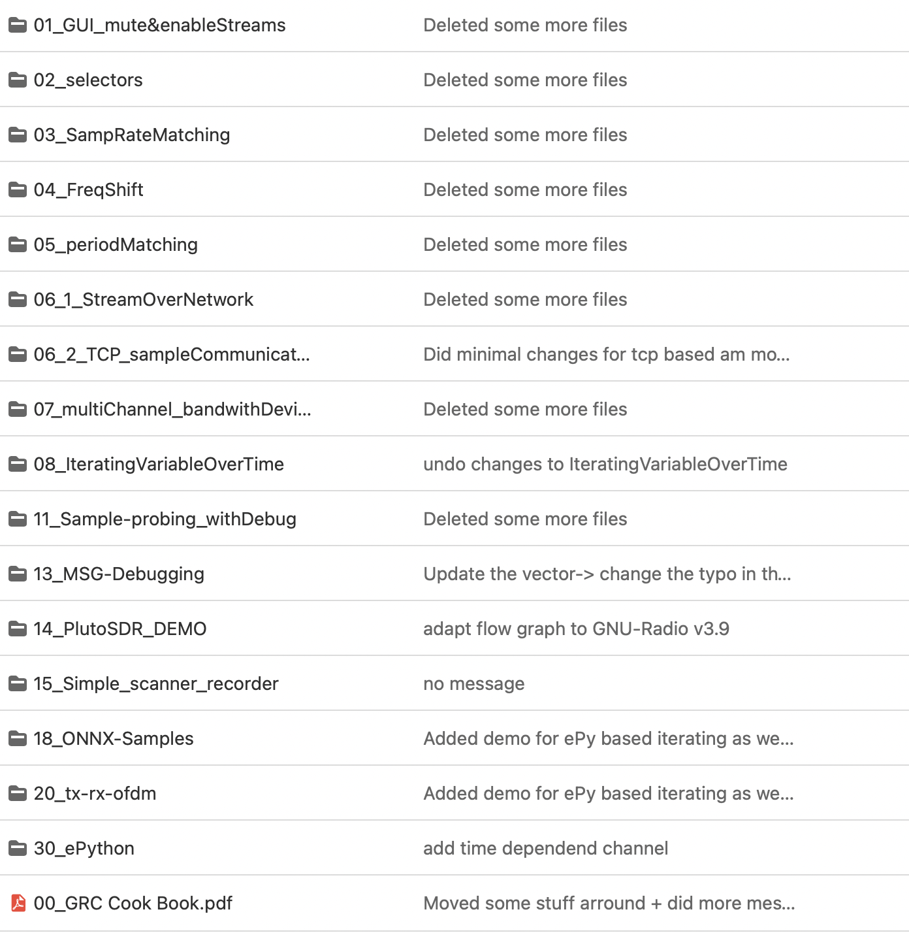
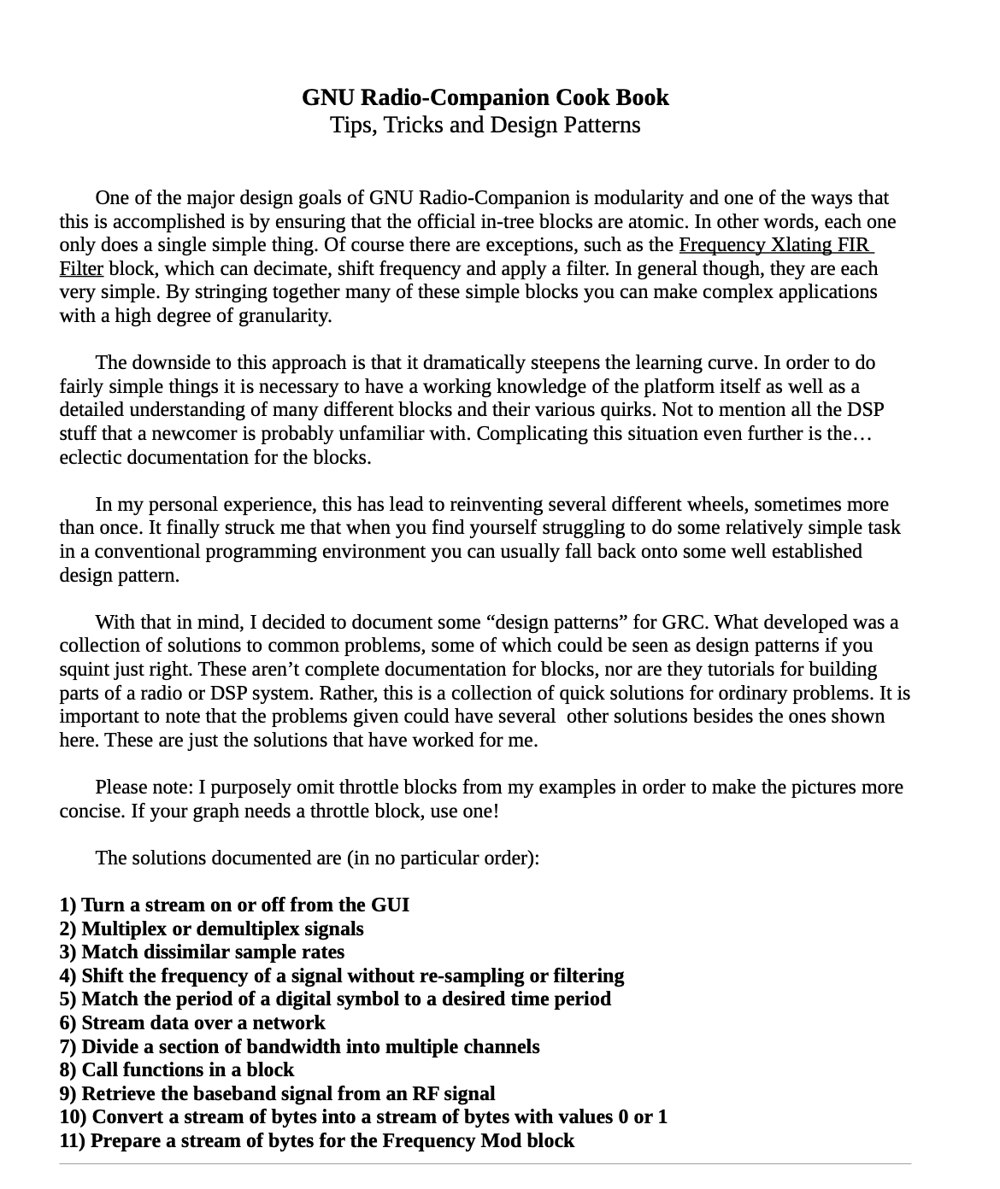
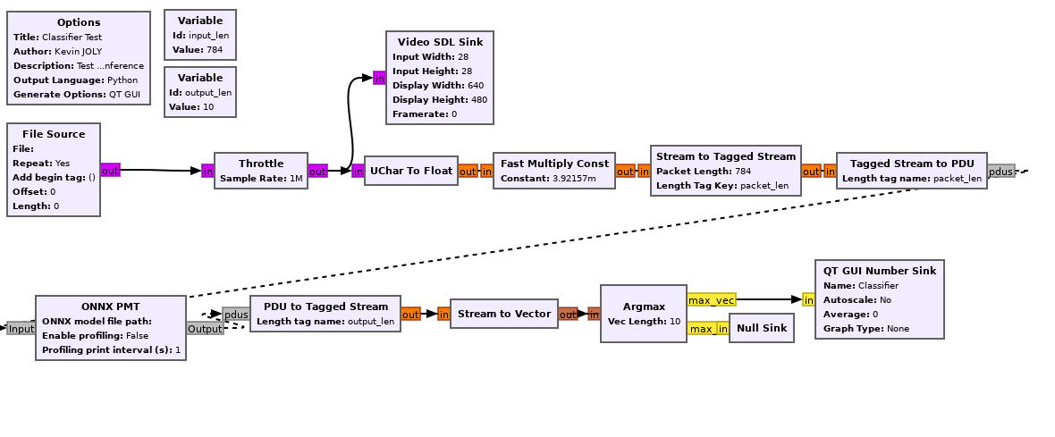
Recommended further reading
All of the previous recommendations @
Field Expedient SDR Volume 1 to 3 by Paul and David Clark ->Beginners Guide for Hands on GRC and SDRs
Web presence | Docu | OOTs
Website Youtube Conference | Wiki Offical Blog BastiBl_Blog GRC-list | Library of OOTs Porting guide
Our Motius GRC-Cookbook
GR-DNN a OOT for Deeplearning with ONNX
Hackaday’s amazing cookbook
Notes:
https://gitlab.motius.de/funki/ap2/gnu-radio

Slide 40
Q&A

Slide 42
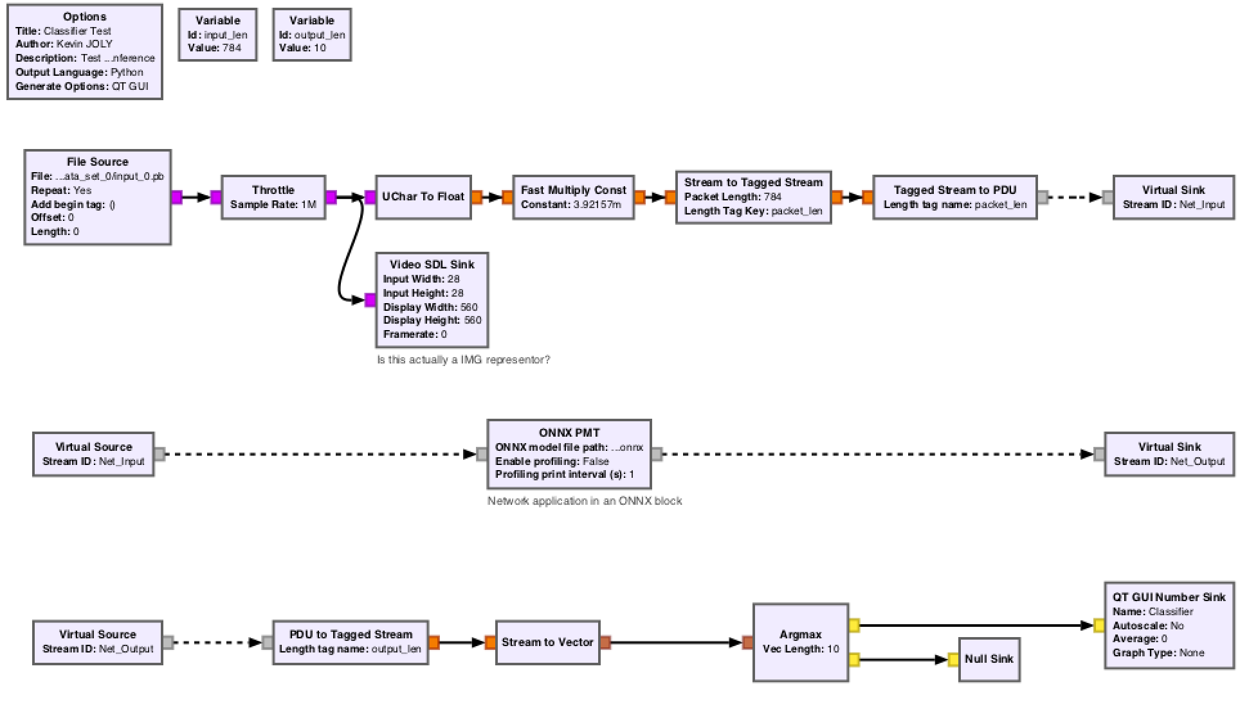
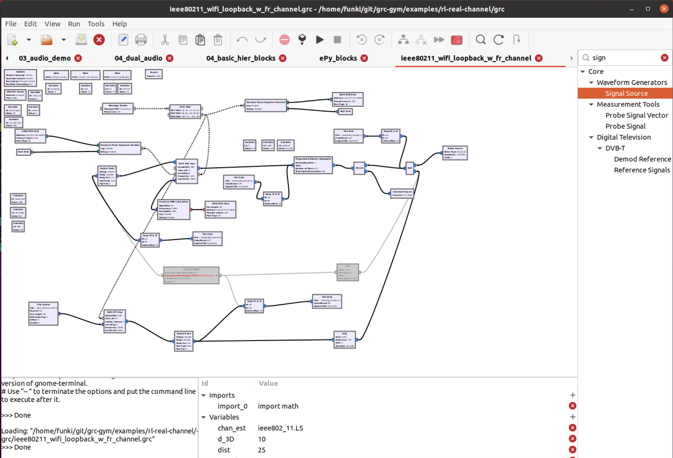
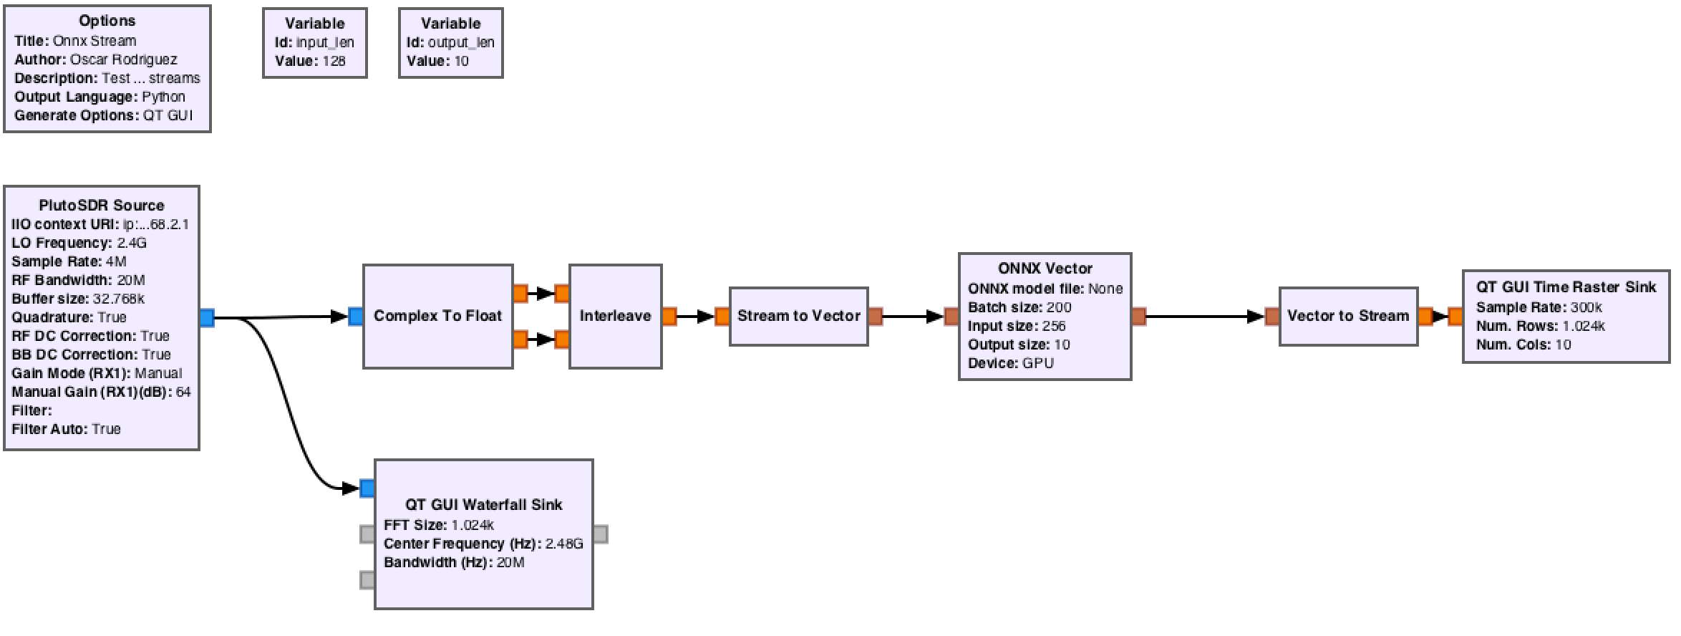

Next time more details on RL in GRC
Presentation of Florian Geiser’s MA-thesis on 30.9.2021
Implmented in GRC 3.8
Based on a OOT module for reinforcement learning
Makes use of the Datarecodring provided by the consortium!
See: https://gitlab.com/librespacefoundation/sdrmakerspace/gr-dnn and the related paper "Deep learning inference in GNU Radio with ONNX" By Rodriguez et. Al.
Notes:
Open Neuronal network exchange

Slide 43



Slide 45


Gnuradio: Flowgraphs and OOTs
GR: a three step process
Creation of a flow-graph in Gnuradio-Companion
Generating python code
Running the graph
“Generate”
Official Modules GRC ships with a large variety of processing blocks
Time-critical/ -sensitive blocks
Purely-representative blocks
basic_signal_fg.py
“Run”
Adding capabilities so far Embedded python blocks: "Living code in the flowgraph"
Notes:
GNU-Radio, Modules like simulink Basically xml file that gets generated by "GRC-companion" -> alternativley you can create the .py by hand (or make changes)

Slide 46




GRC: Flowgraphs and OOTs
Problems with embedded python blocks:
Speed
The fact that they live in the graph, makes them hard to share and update
“Generate”
Adding more functionality: Out of tree-modules Modules and their blocks add to the capability of GRC
With different groups working on and with GRC, a broad set of OOT found on the internet
Block creation with the gr_modtool
basic_signal_fg.py
“Run”
/
3.9
Notes:
GNU-Radio, Modules like simulink Basically xml file that gets generated by "GRC-companion" -> alternativley you can create the .py by hand (or make changes)

Slide 47


A simple SDR transmitter and reciever
Notes:
https://www.intechopen.com/chapters/70491

Slide 48

SDR VS HDR

Slide 49
Task 1.c.1: Anwedungsfälle und Szenarien
Task 2.a.1: Analyse von verschiedenen ML-Ansätzen für den Einsatz bei der Signaldetektion (zur Laufzeit)
Task 2.a.2: MIMO Kanalschätzung und -entzerrung durch neuronale Netze
Task 2.a.3: Adaption von MIMO-OFDM Systemen mittels neuronaler Netze
Task 2.c.1: Untersuchung von geeigneten ML-Verfahren für die Signalverarbeitungskette von Mehrträgermodulationsverfahren
Task 2.c.2: Training der Neuronalen Netze und Simulation des Gesamtsystems
Task 2.c.3: Entwurf und Implementierung des End-to-End Systems durch Auto-Encoder
Task 3.a.1: Analyse von geeigneten Verfahren für die KI-basierte Kanaladaption und Entwicklung einer Simulationsumgebung
Task 3.a.2: Implementierung der Kanaladaption basierend auf den geschätzten und vorhergesagten Kanalparametern
Task 3.b.1: Evaluierung geeigneter ML-Verfahren für die gemeinsame Kanalparameterschätzung
Task 3.b.2: Entwicklung des KI-Verfahrens für die gemeinsame Parameterschätzung
Task 3.d.1: Radio Traffic Sequenz Detektion und Interferenz Management für dynamische Kanalzugriffsverfahren
Task 3.d.2: Entwurf einer Simulationsumgebung für den Test von dynamischen Kanalzugriffsverfahren
Task 5: Demonstratorplattform

Slide 50



Using GRC: Creating emebeded Python blocks
Example Filtering
http://blog.sdr.hu/grblocks/xlating-fir.html
http://www.trondeau.com/blog/2014/2/27/to-use-or-not-to-use-fft-filters.html
Notes:
GNU-Radio, Modules like simulink

Slide 51

Using GRC: Creating Out Of Tree modules
Basic concept #1: Data flows from source to sink
http://www.pg540.org/wiki/index.php/ADALM-PLUTO_(SDR_rx/tx)_notes
https://github.com/unixpunk/PlutoWeb
Notes:
GNU-Radio, Modules like simulink

